Slide 1



Wio Terminal – Part 2 Hands-on: Gesture Recognition
Prof. Marcelo José Rovai
UNIFEI - Federal University of Itajubá, Brazil
TinyML4D Academic Network Co-Chair

Slide 2
Hands-on: Gesture Recognition

Slide 3
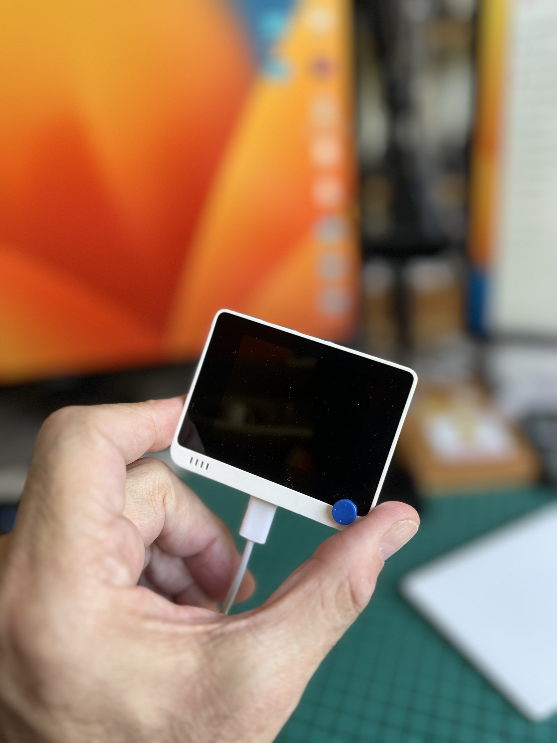
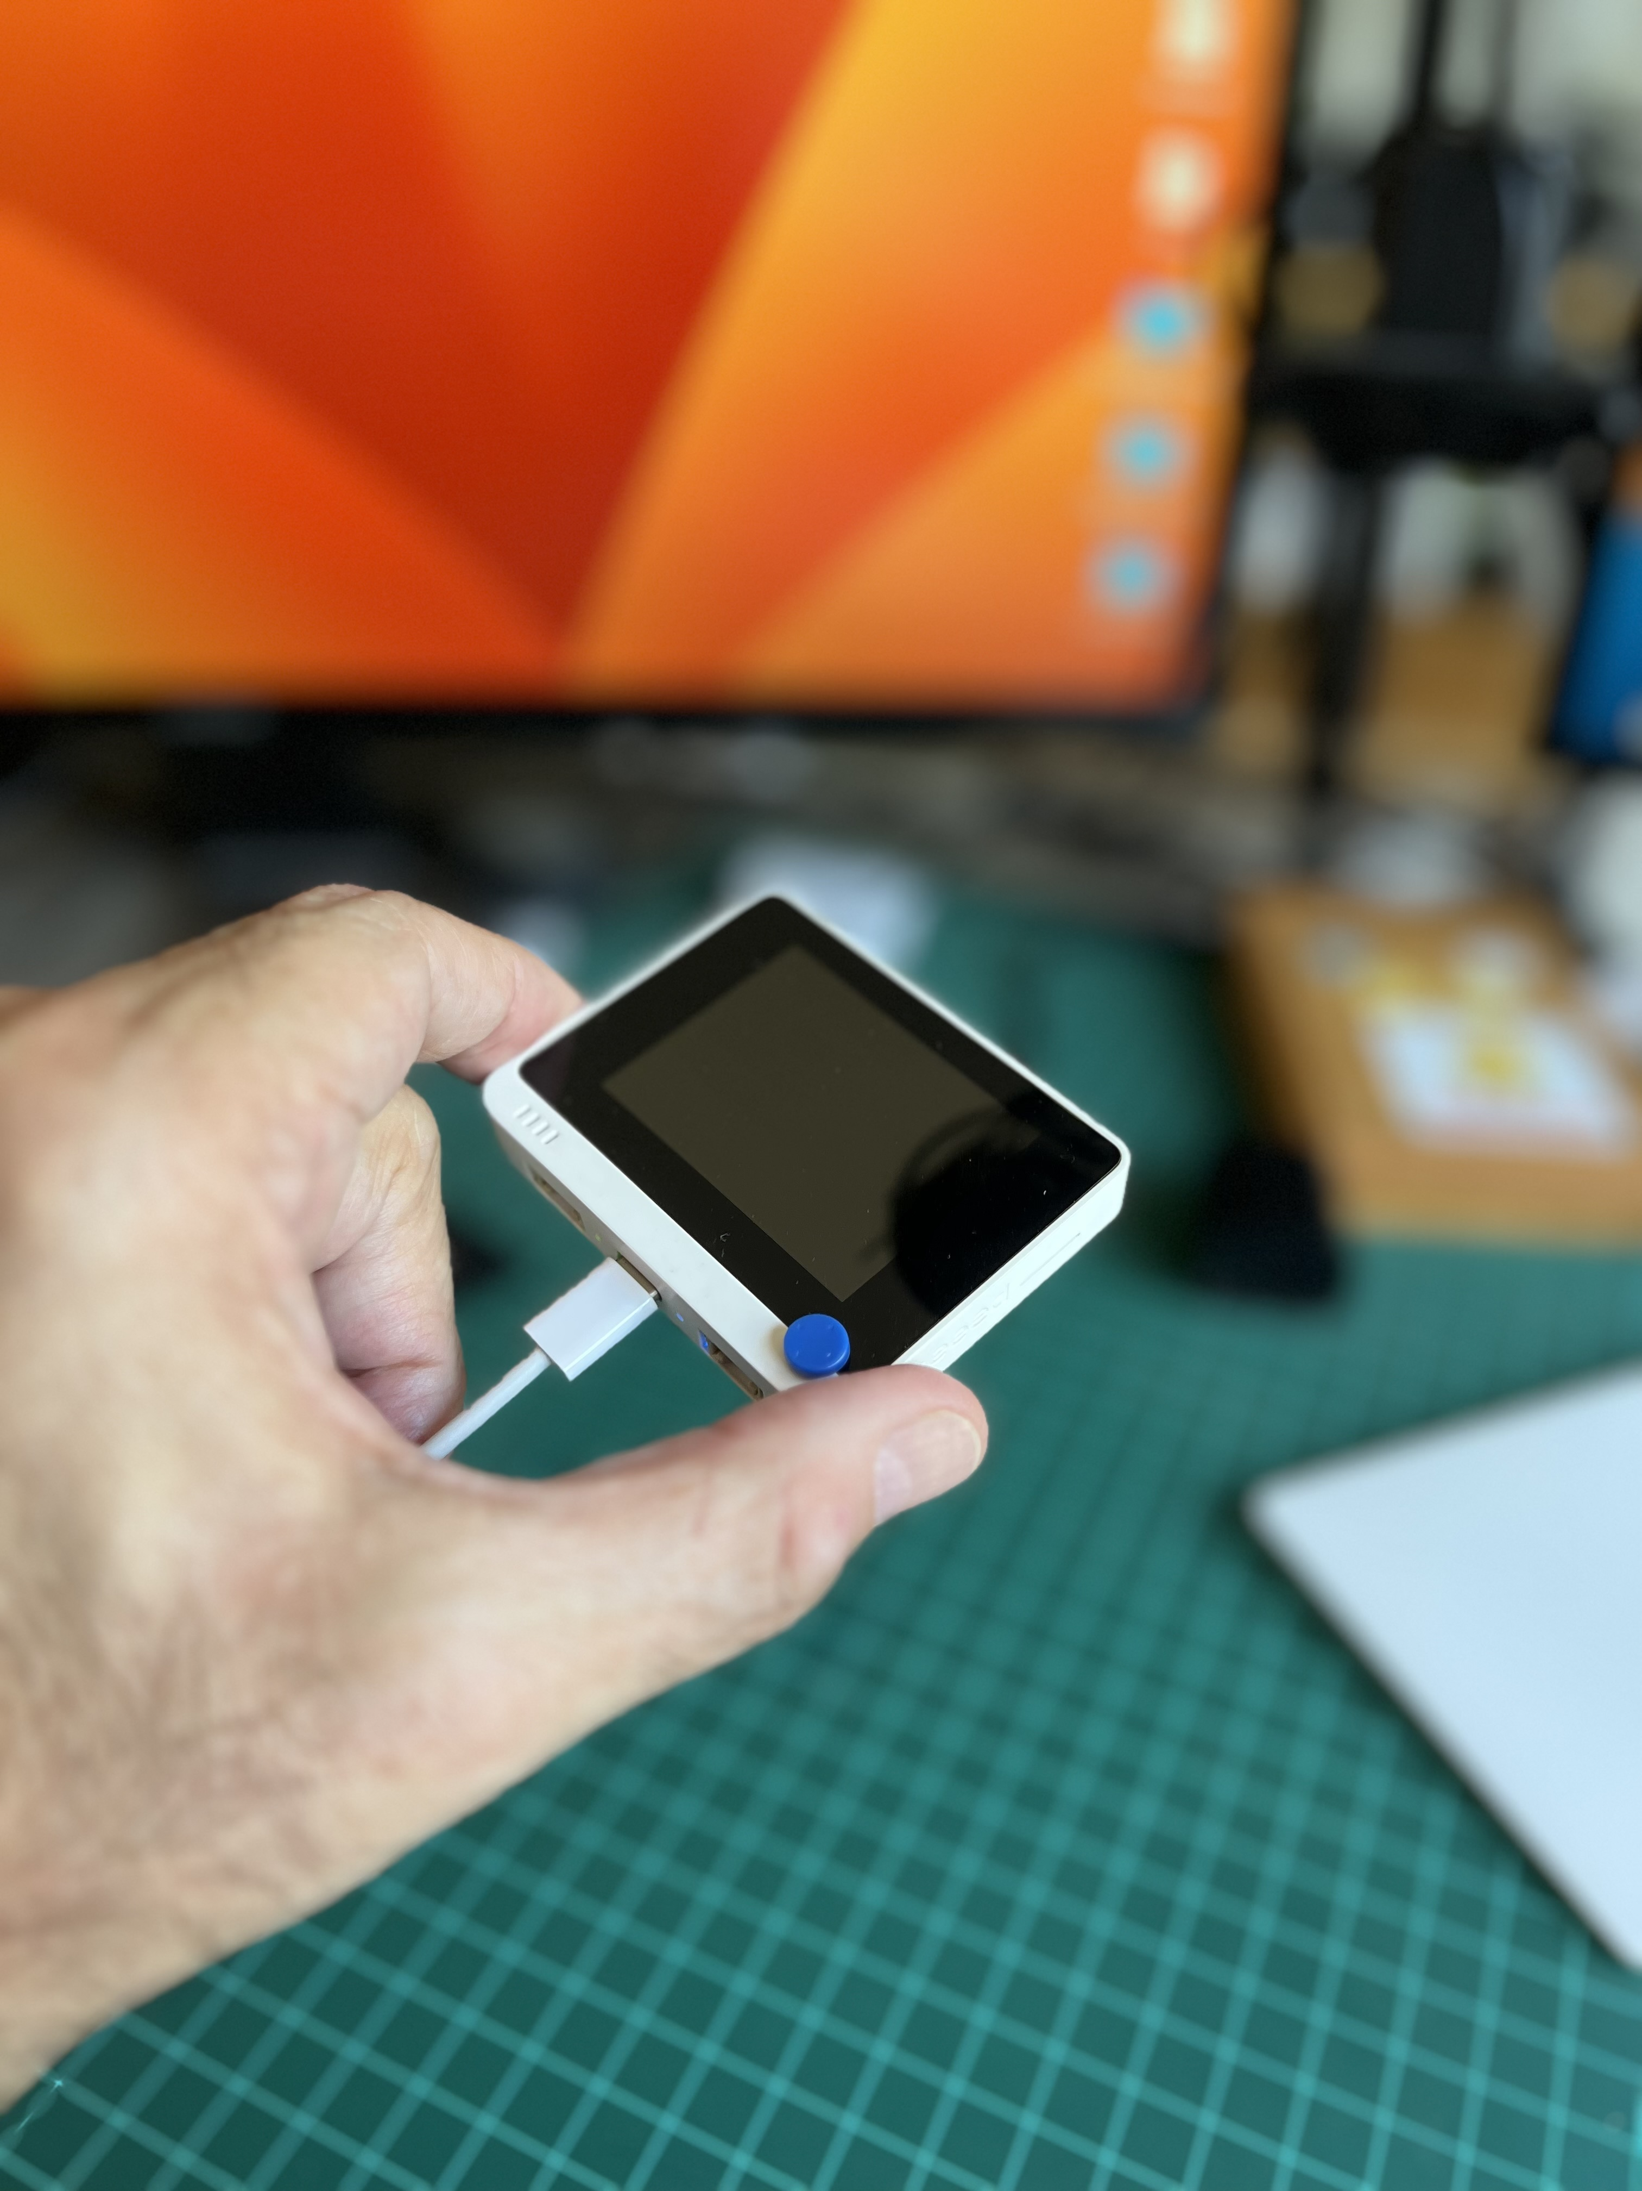
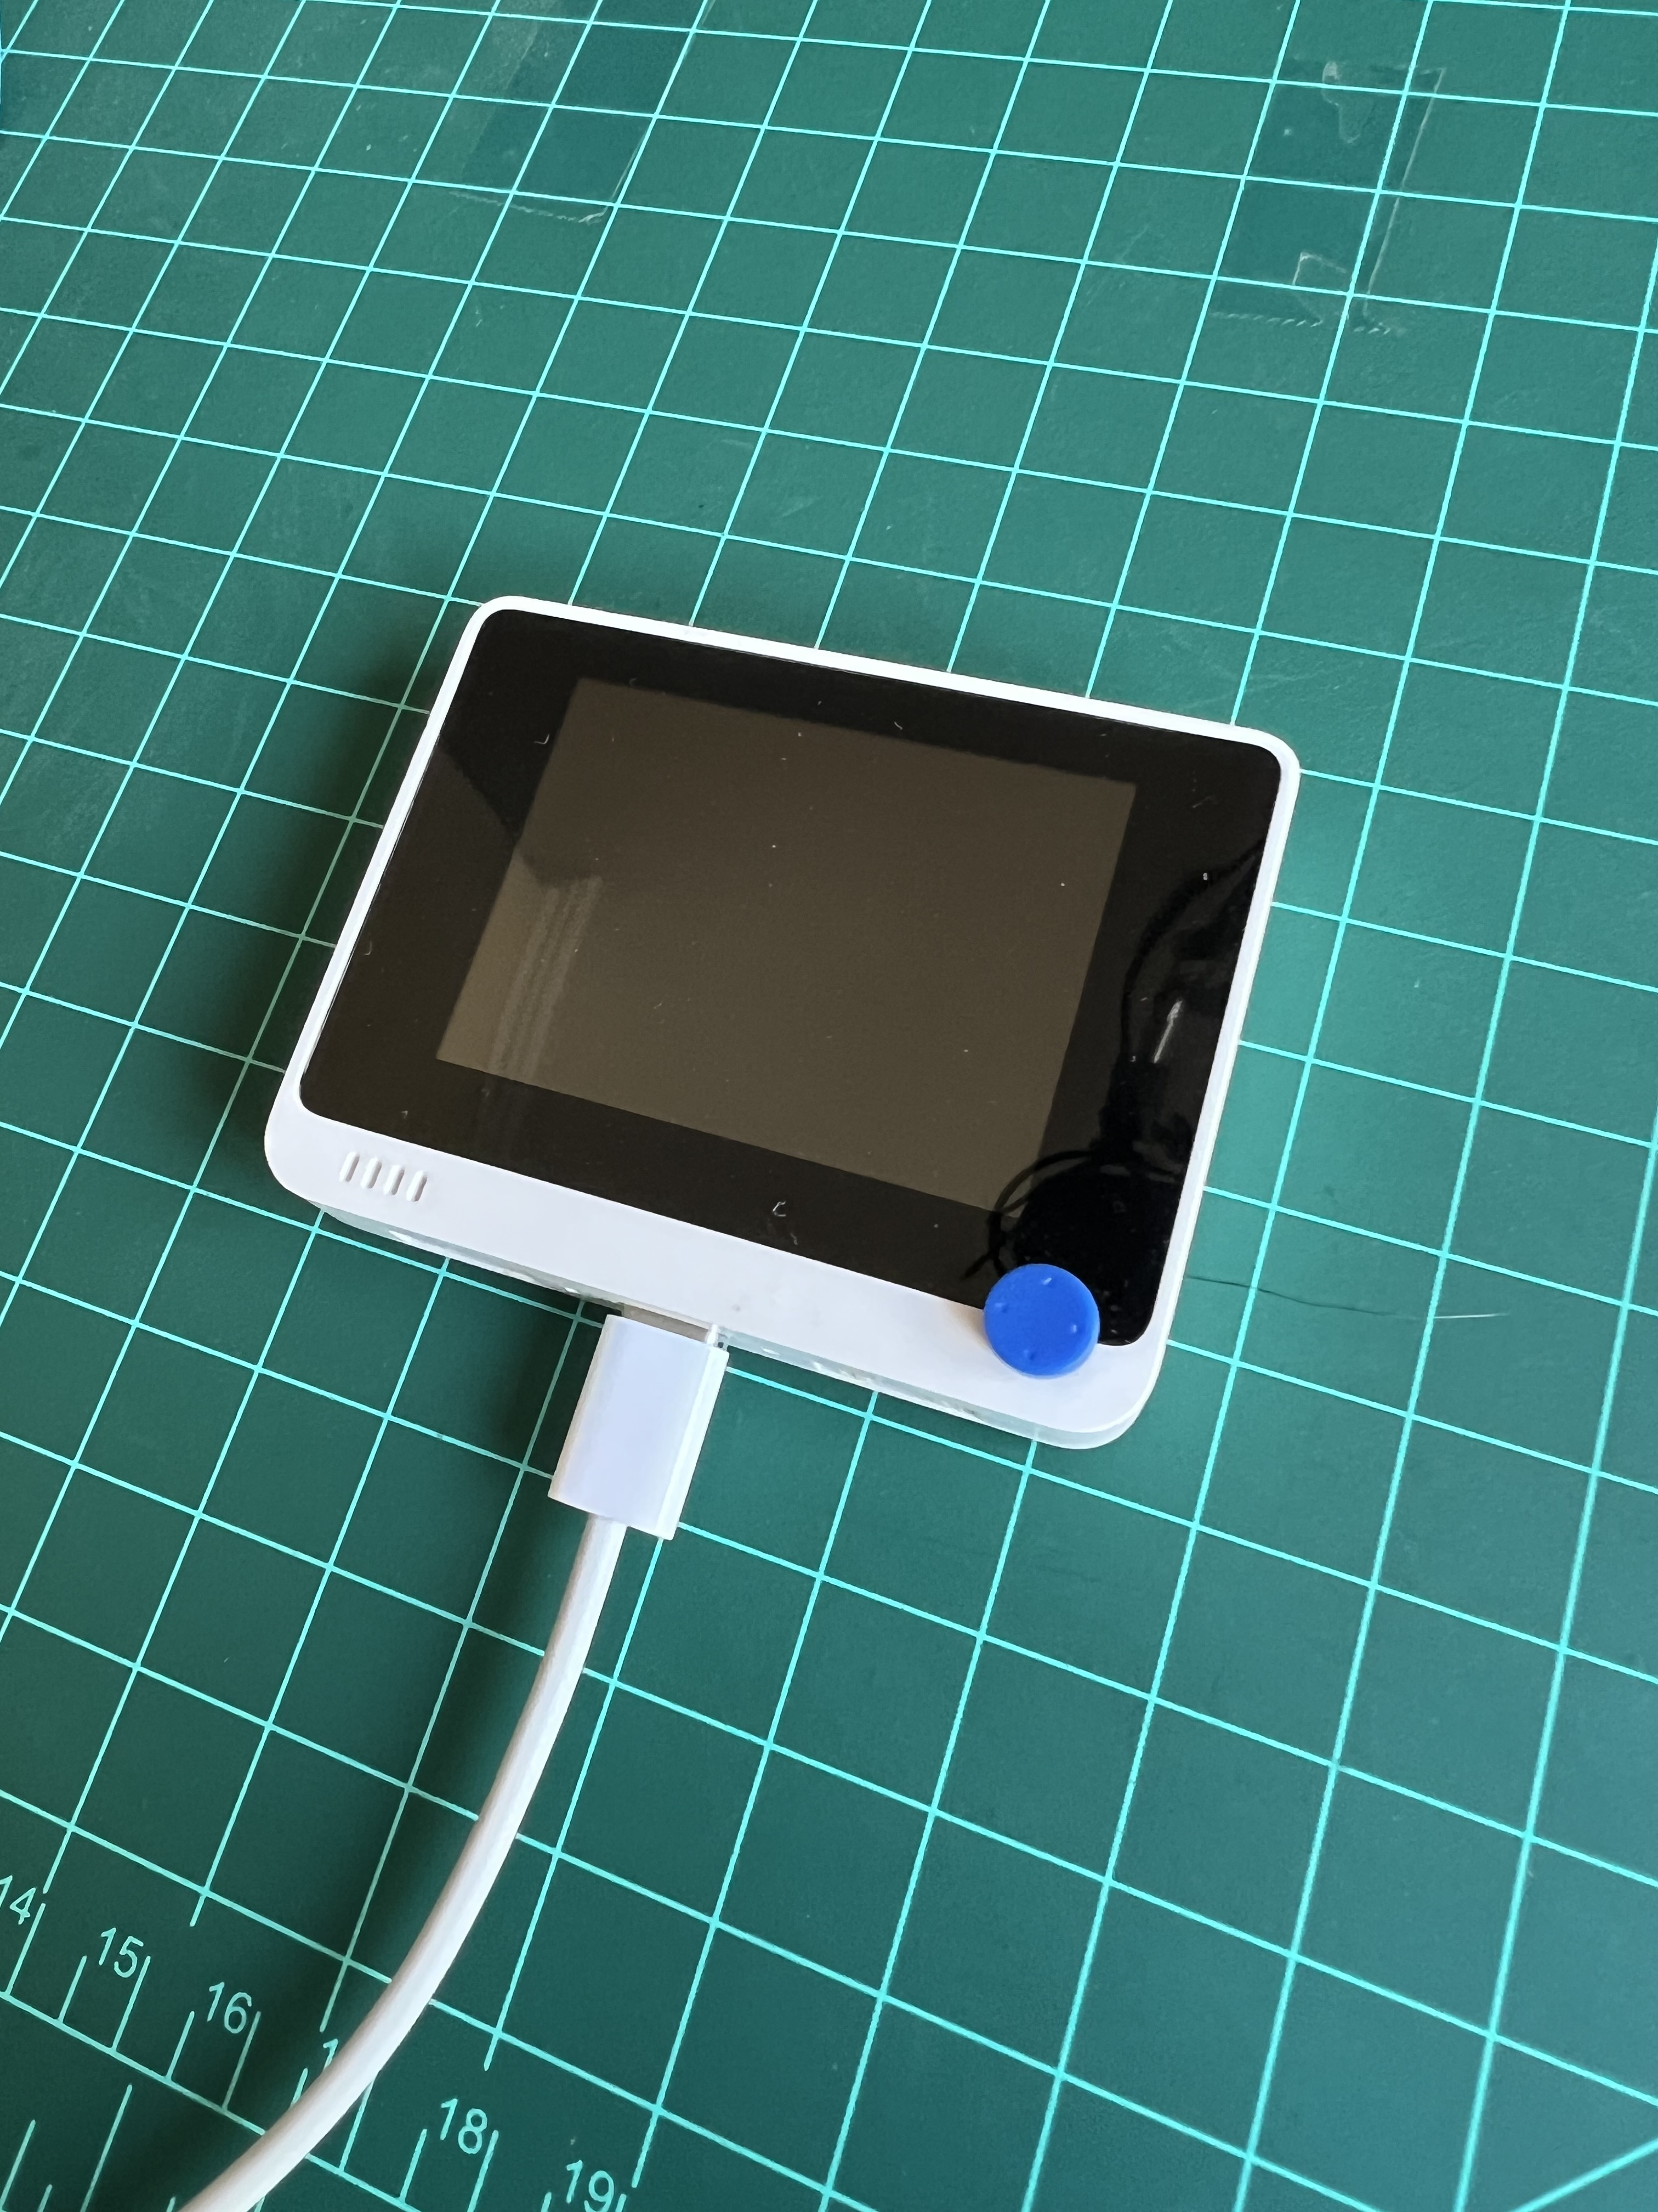
Gestures Definition (classes)
idle
left-right
up-down

Slide 4
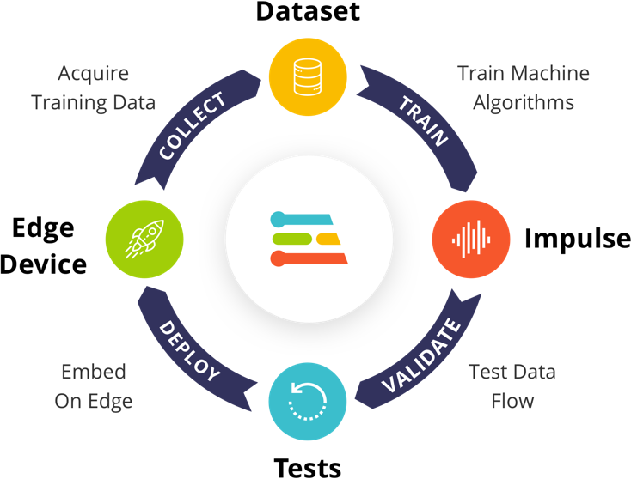
Pre-Processing Data
Design a Model
Train a Model

Slide 5
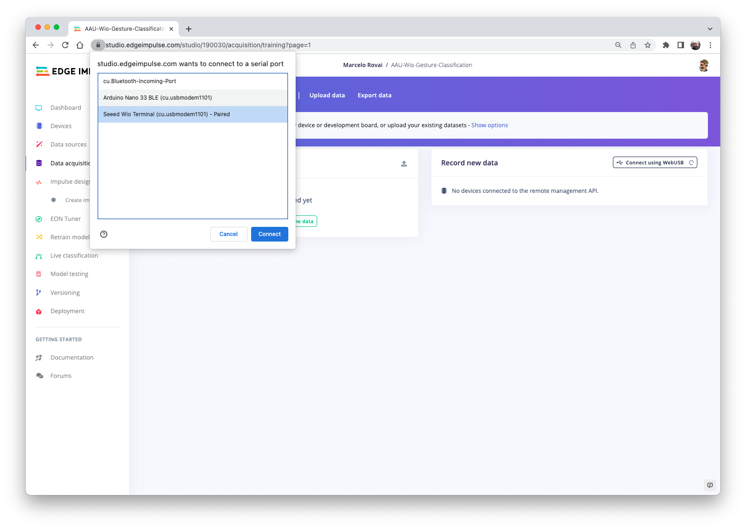

Slide 6
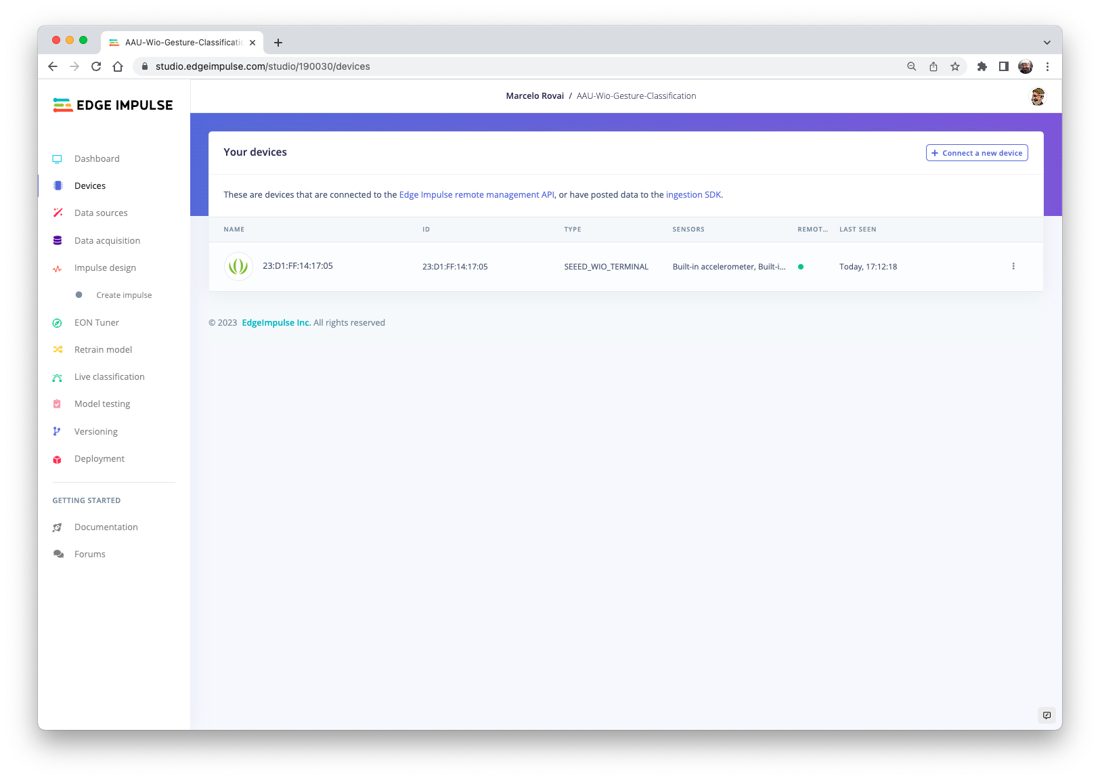

Slide 7
Pre-Processing Data
Design a Model
Train a Model

Slide 8
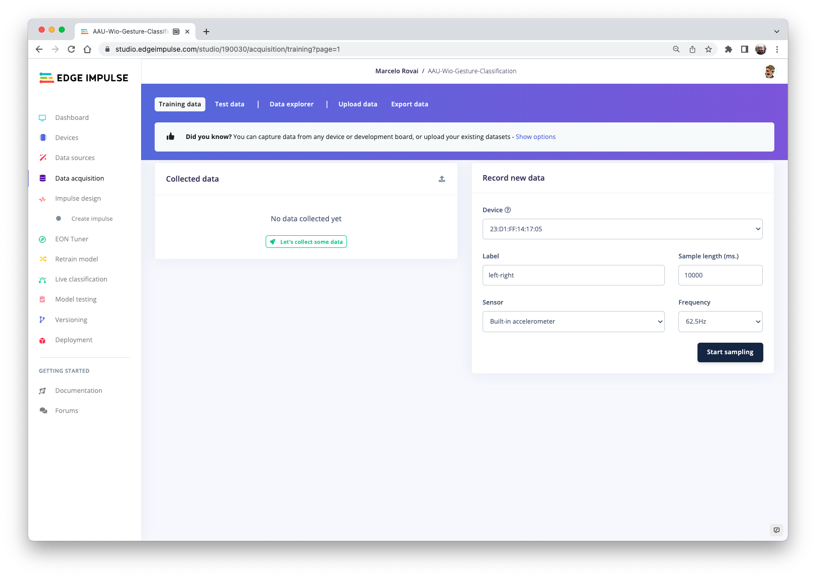

Slide 9
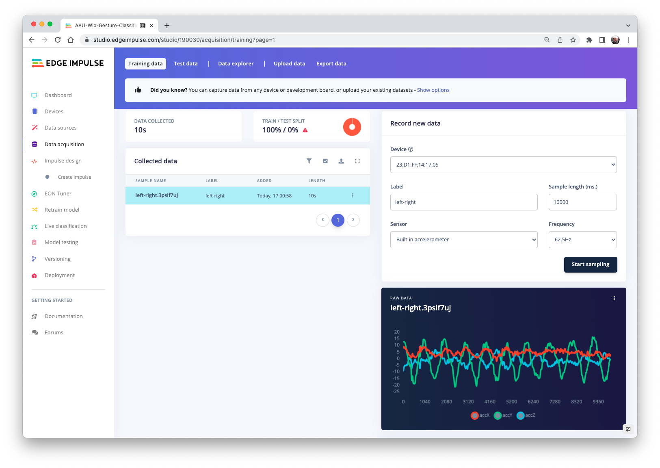

Slide 10
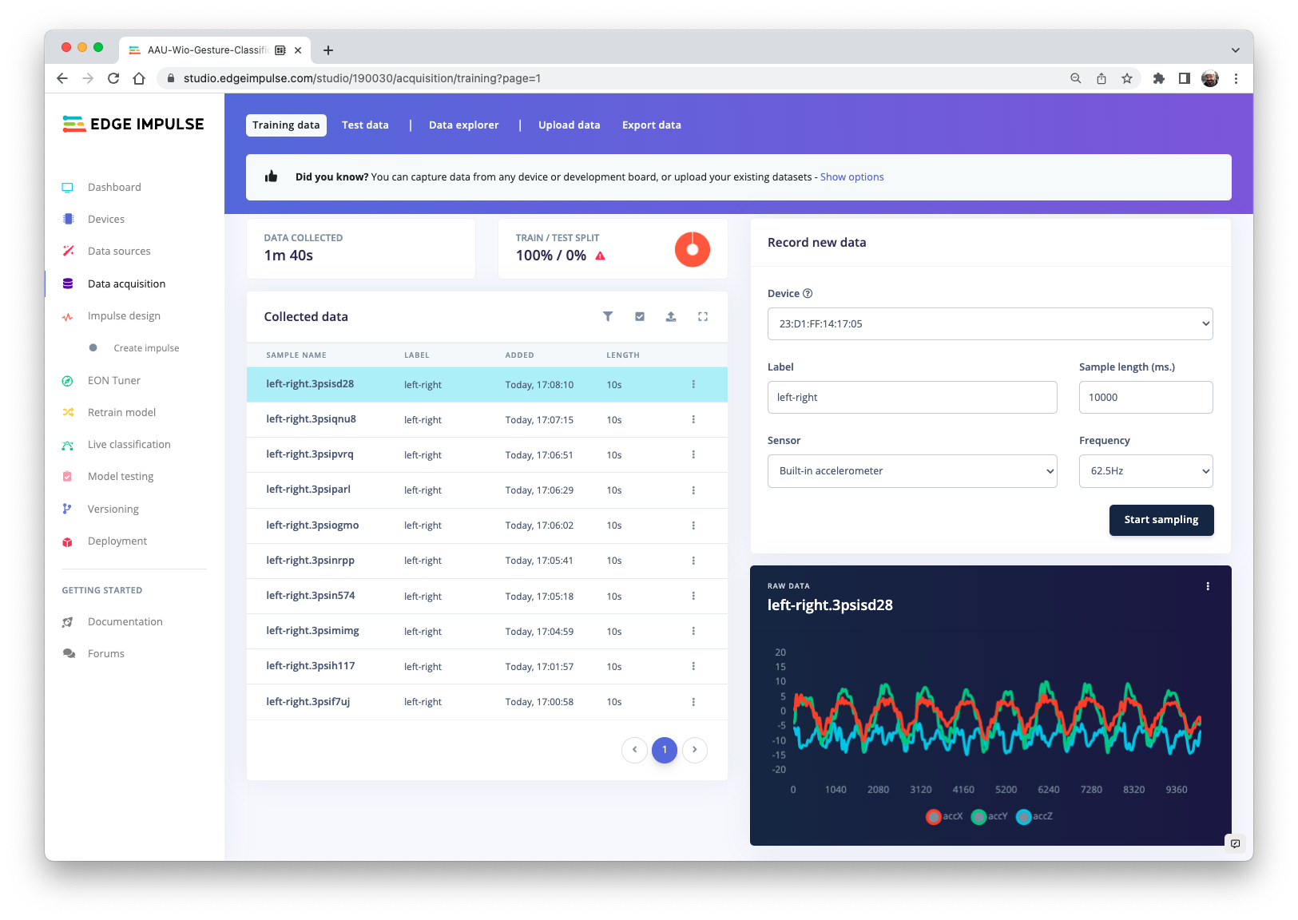

Slide 11
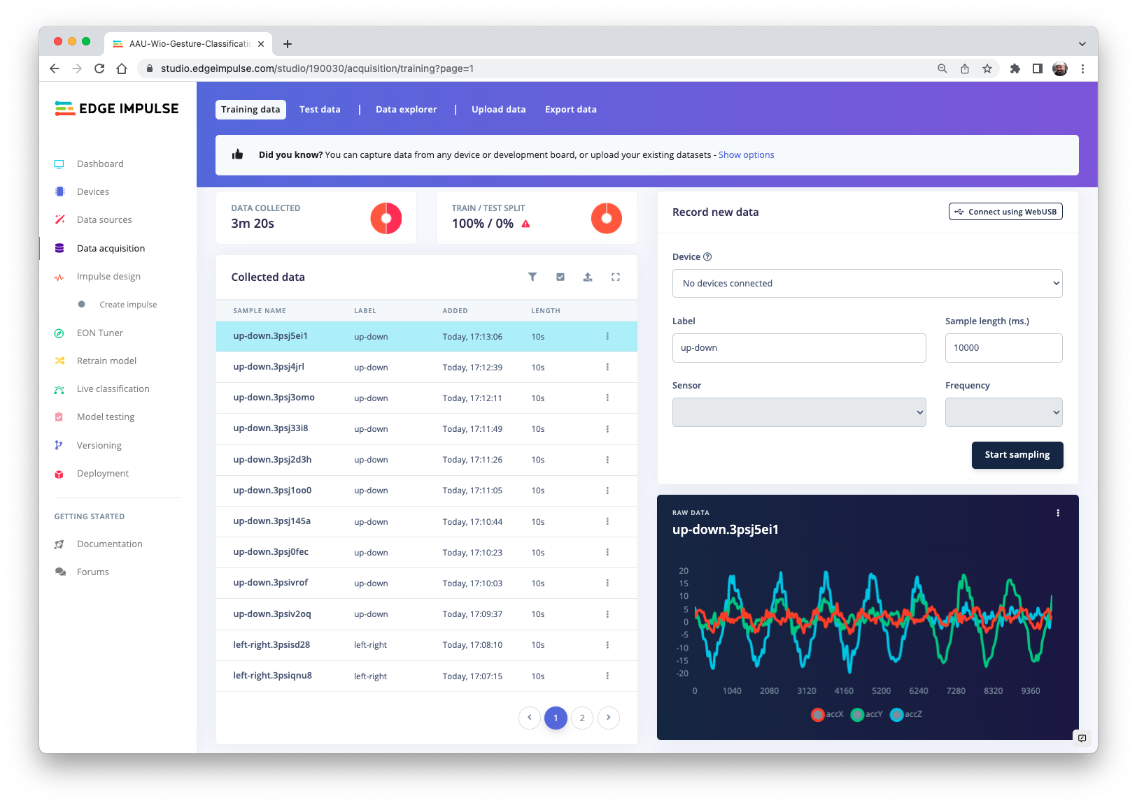

Slide 12
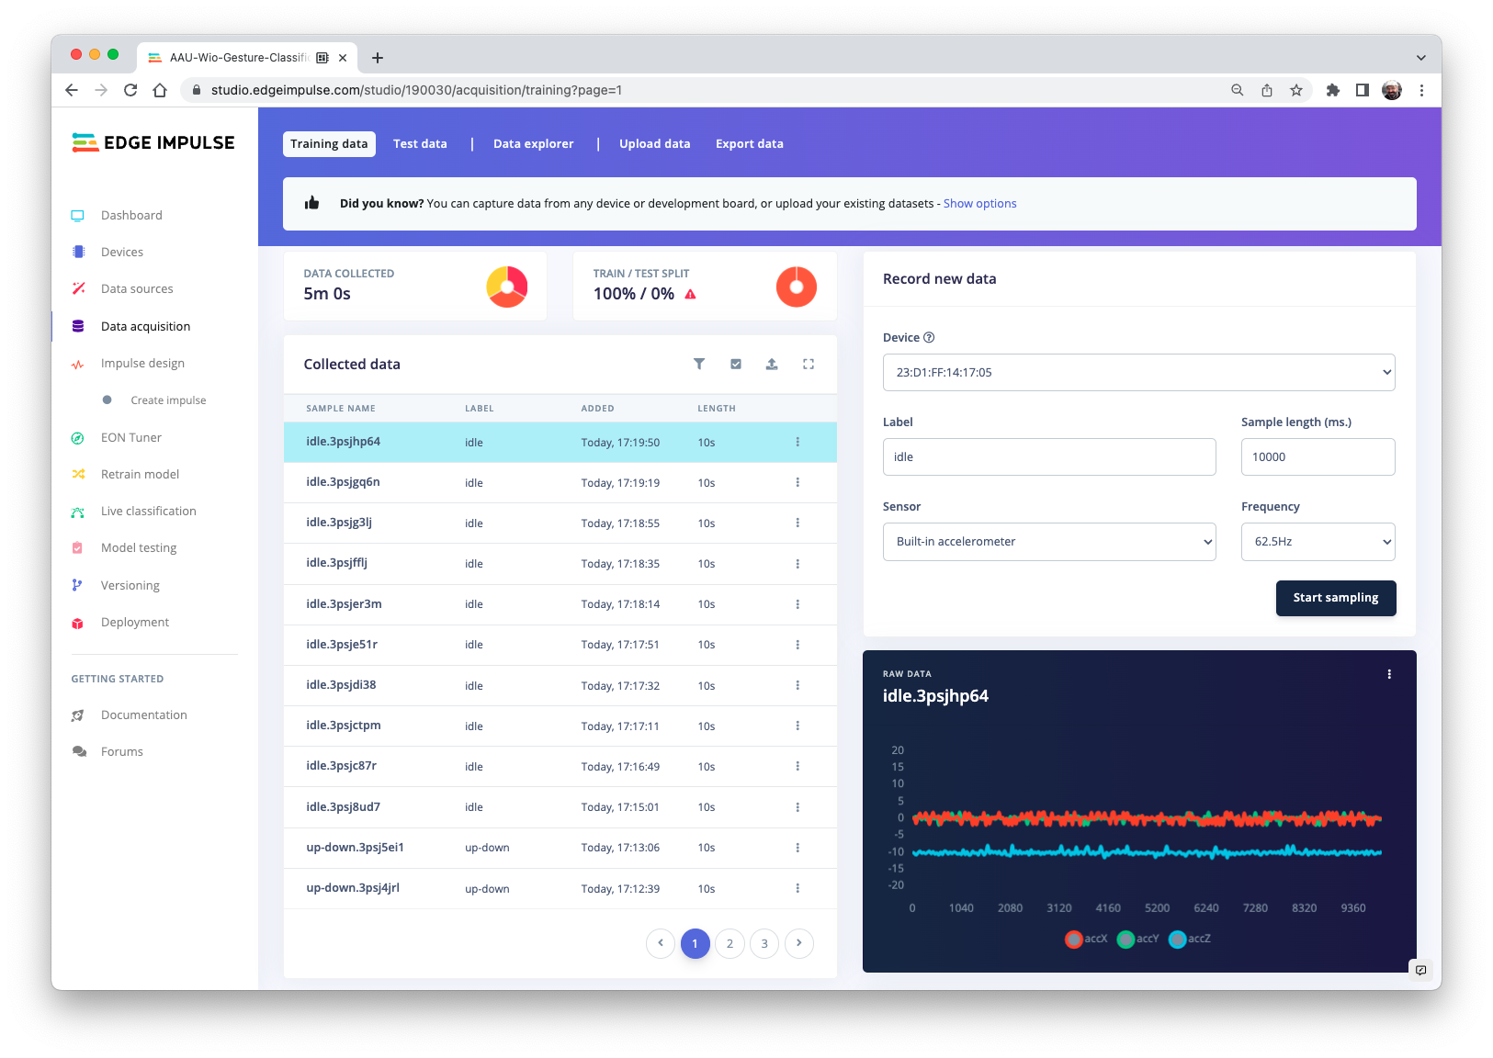

Slide 13
Original Dataset
Training Set
Test Set
Training Set
Validation Set
Test Set
Training, tuning,
evaluation
Machine Learning Algorithm
Final Performance Estimate
Final Model
Notes:
https://thenounproject.com/search/?q=confused&i=1429617

Slide 14
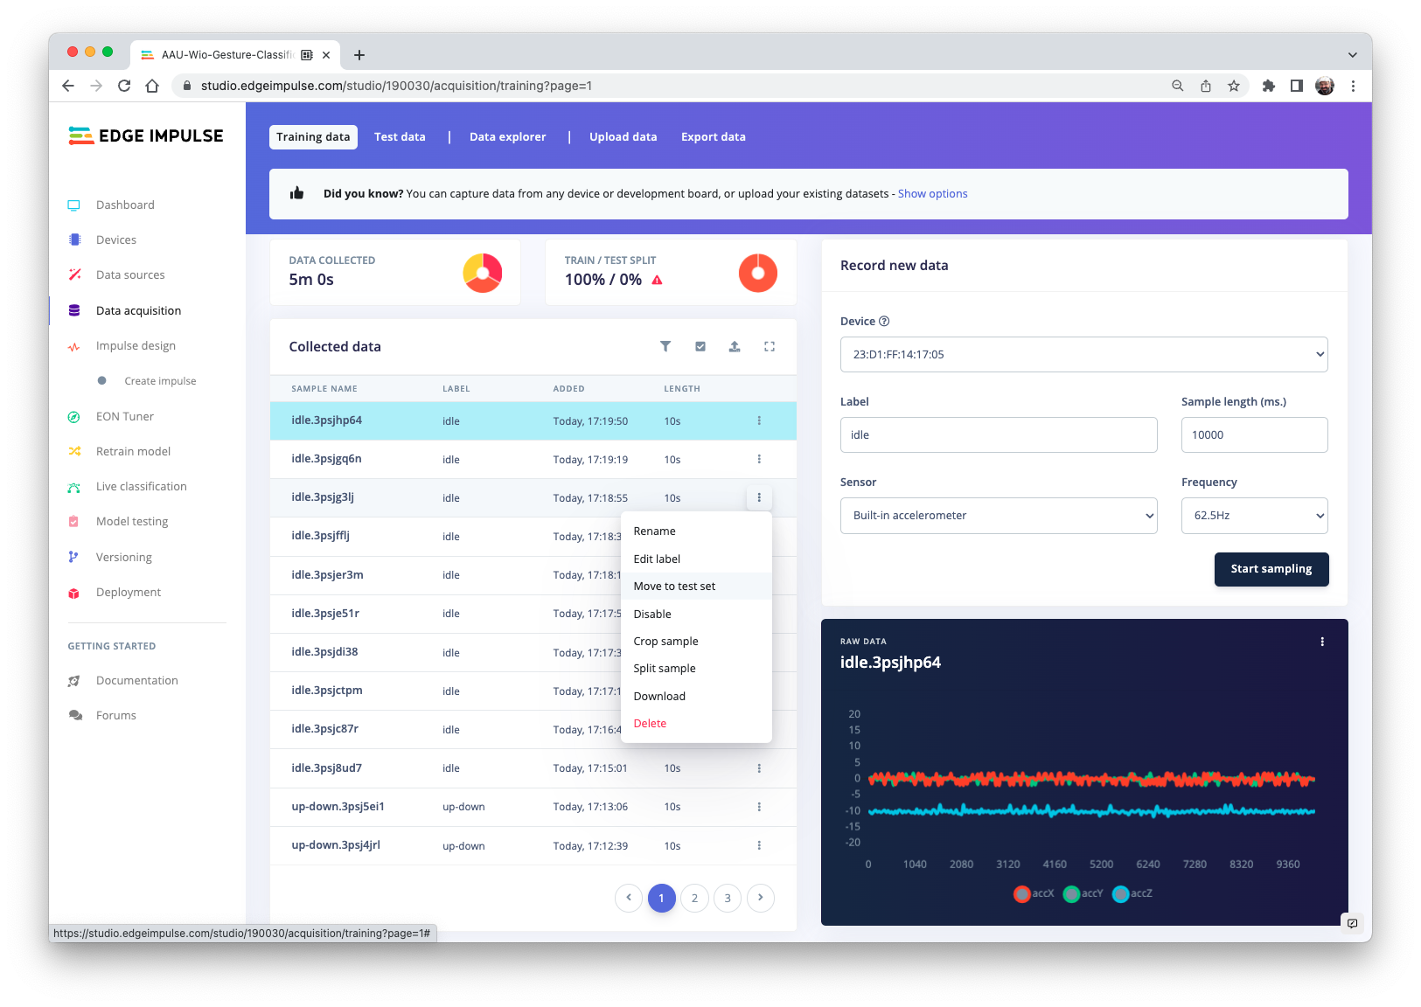

Slide 15
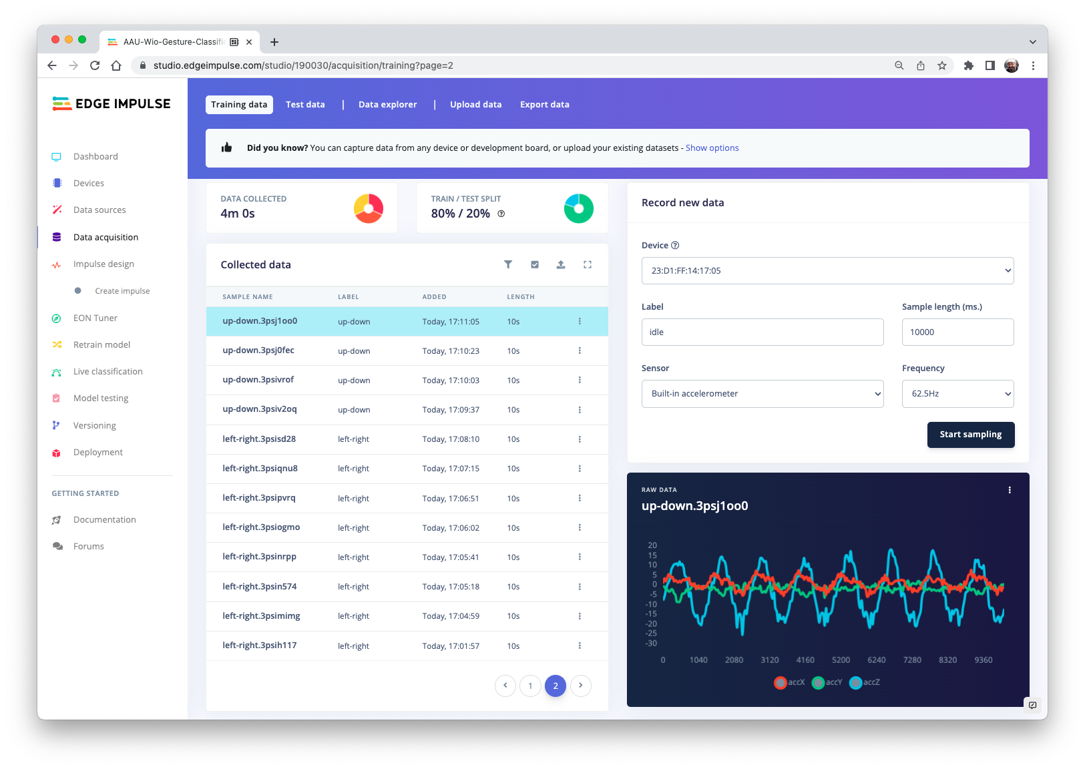

Slide 16
Pre-Processing Data
Design a Model
Train a Model

Slide 17
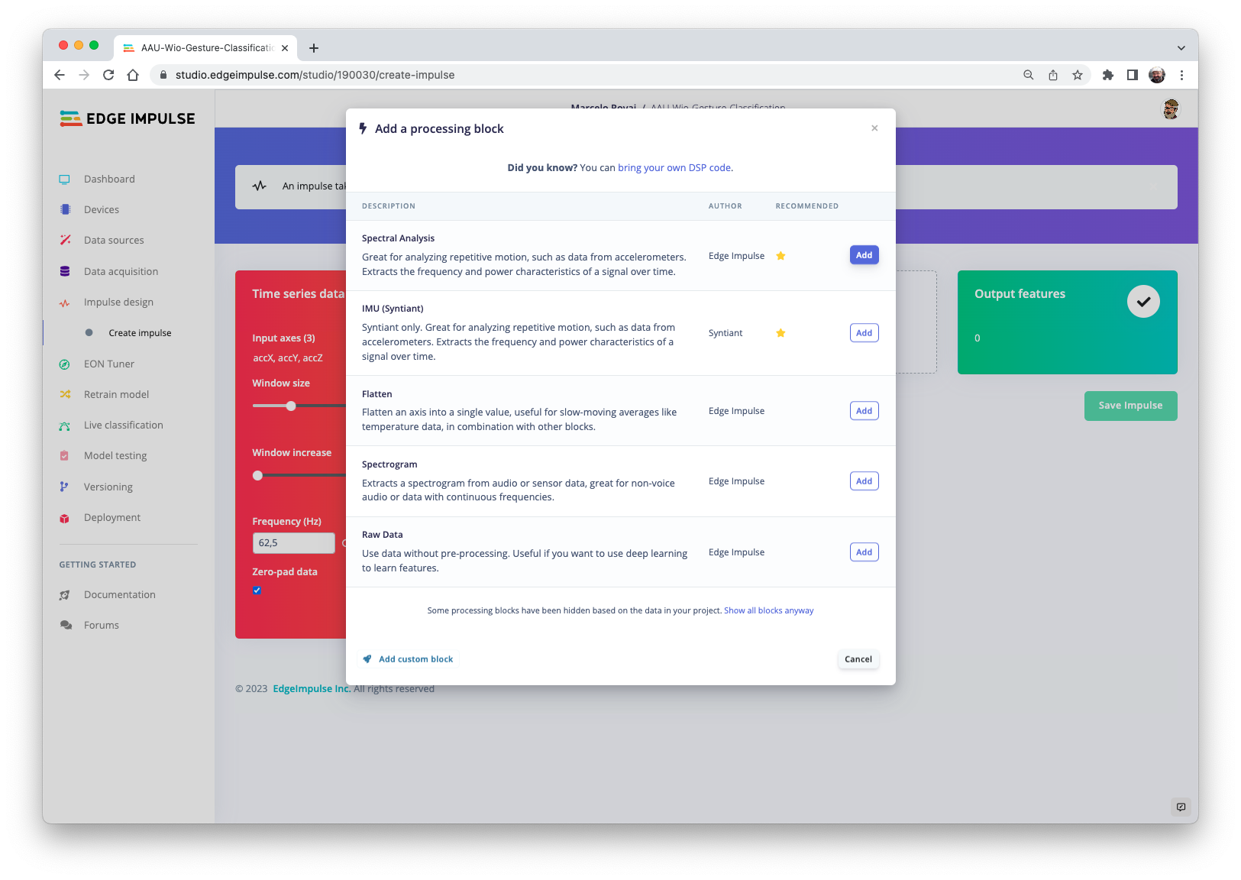

Slide 18
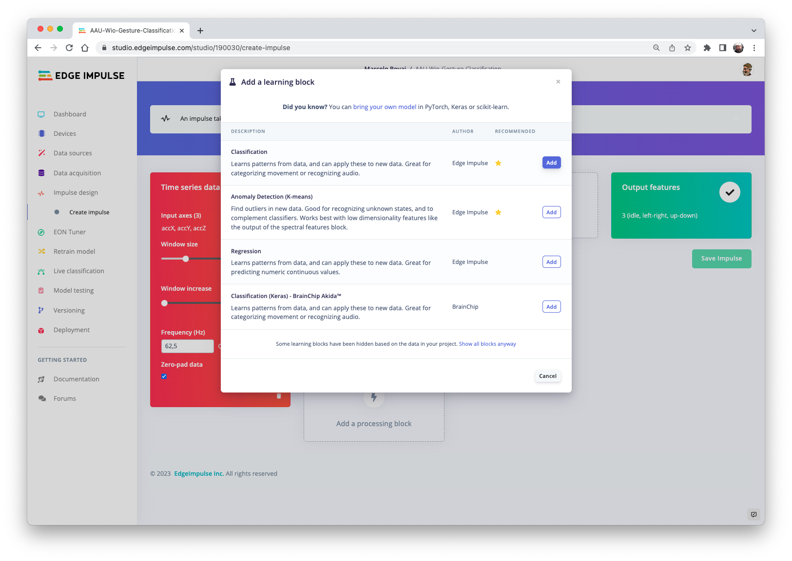

Slide 19
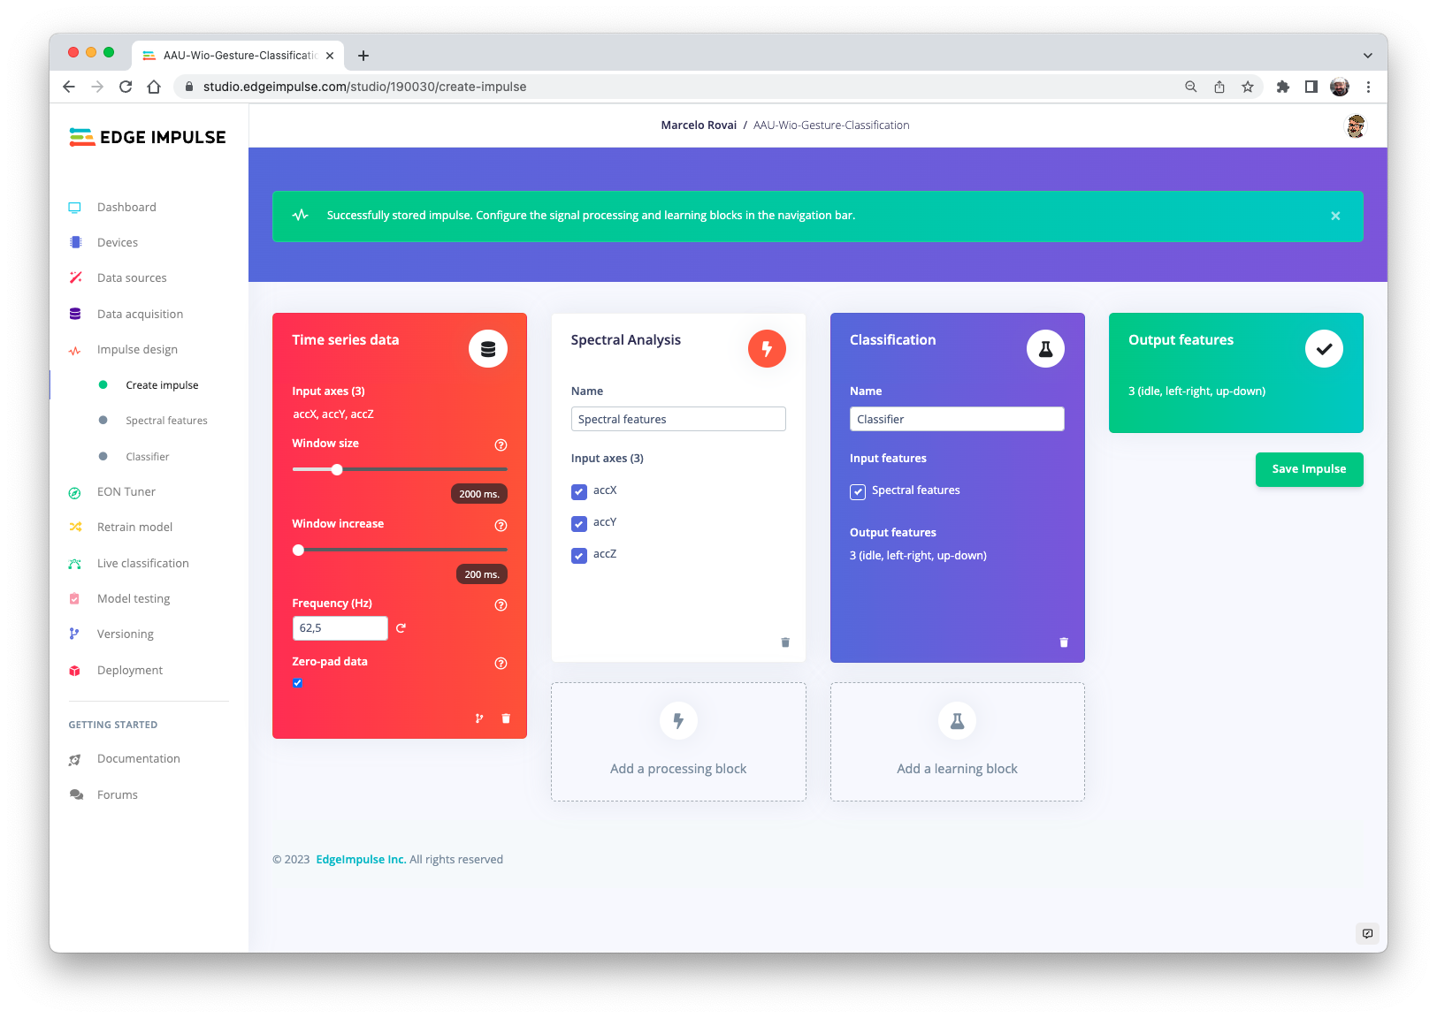

Slide 20
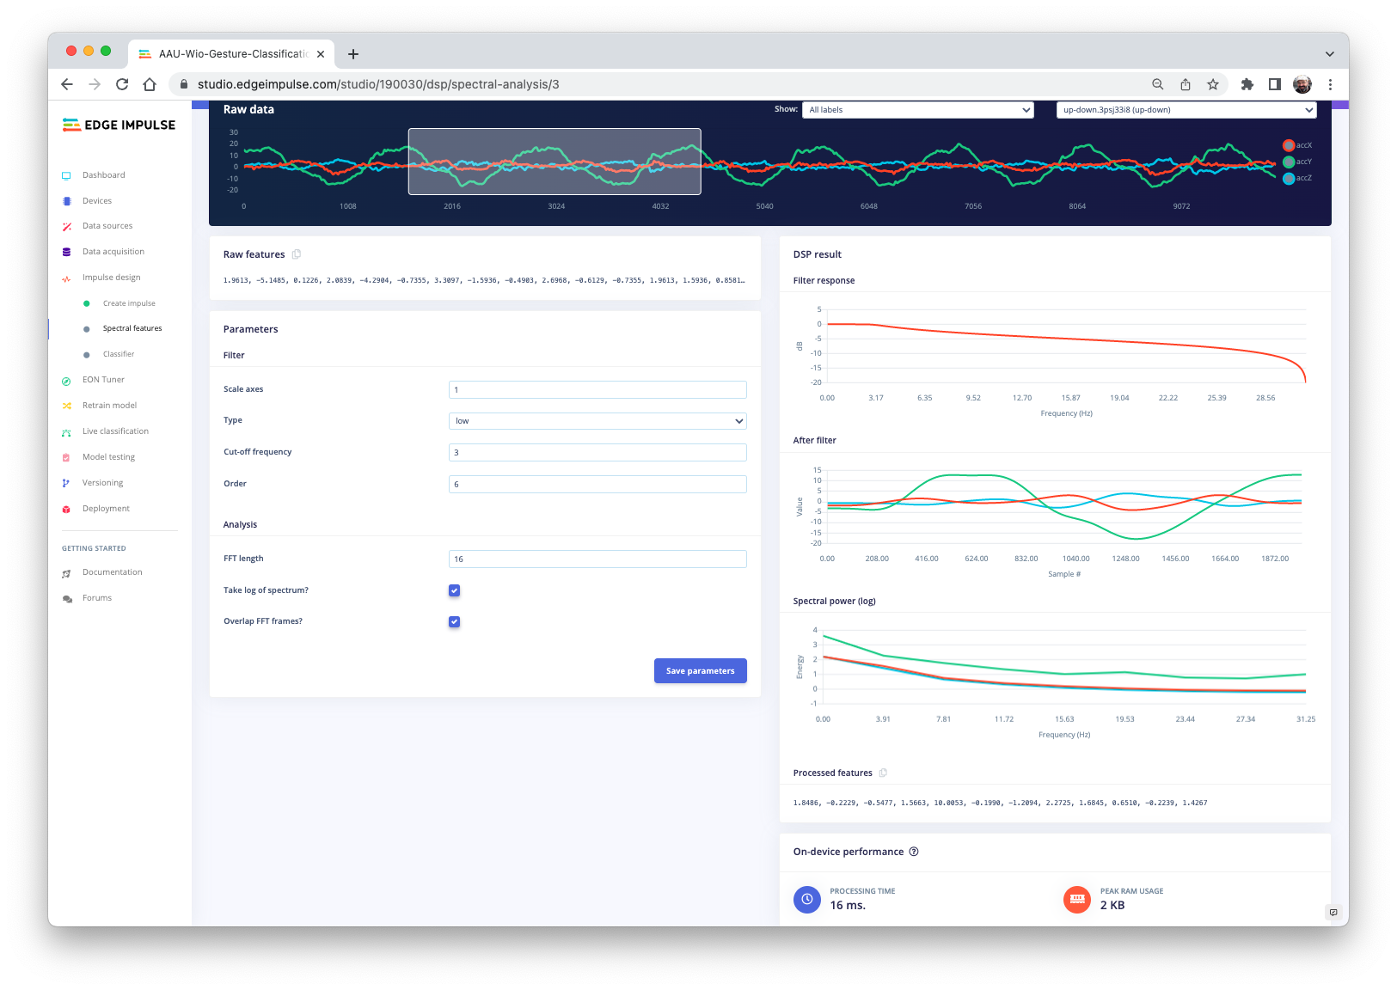

Slide 21
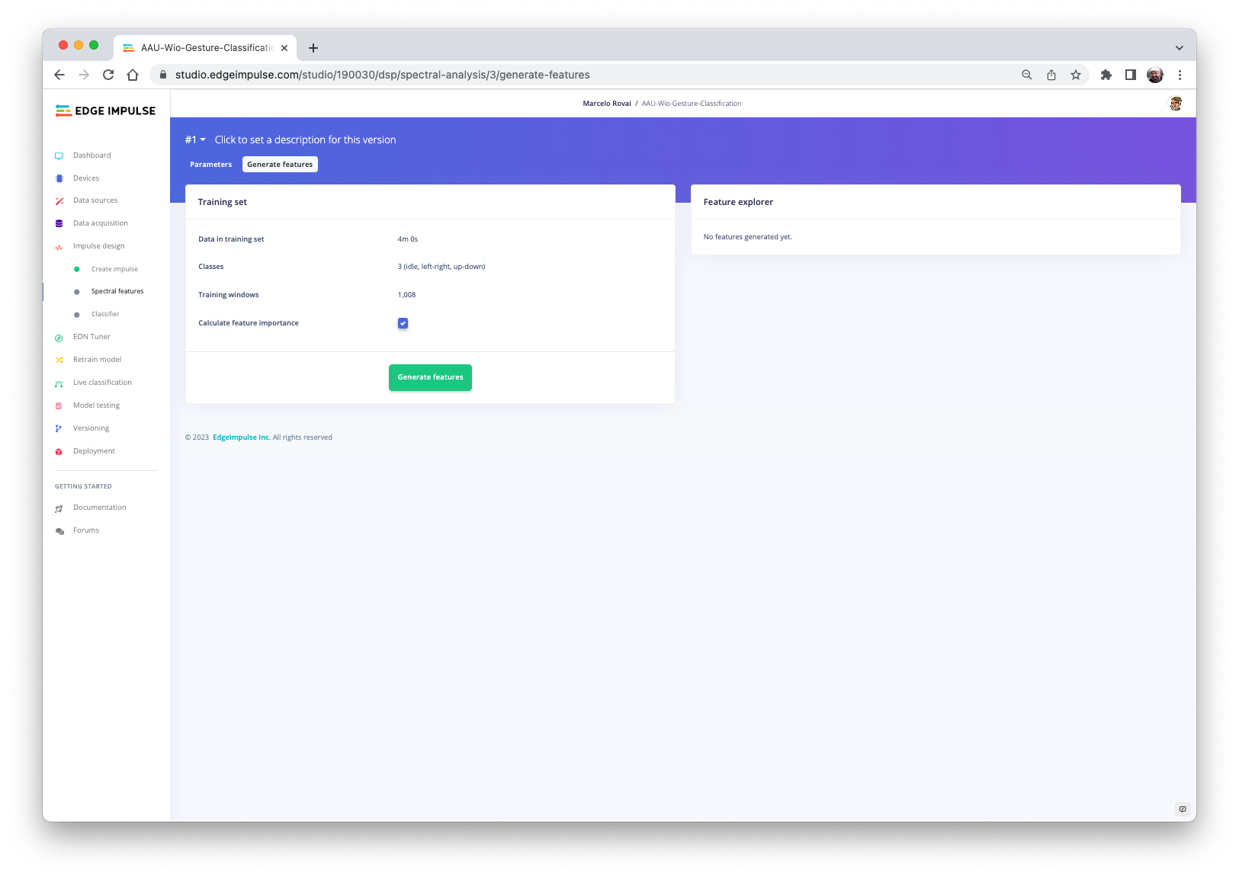

Slide 22
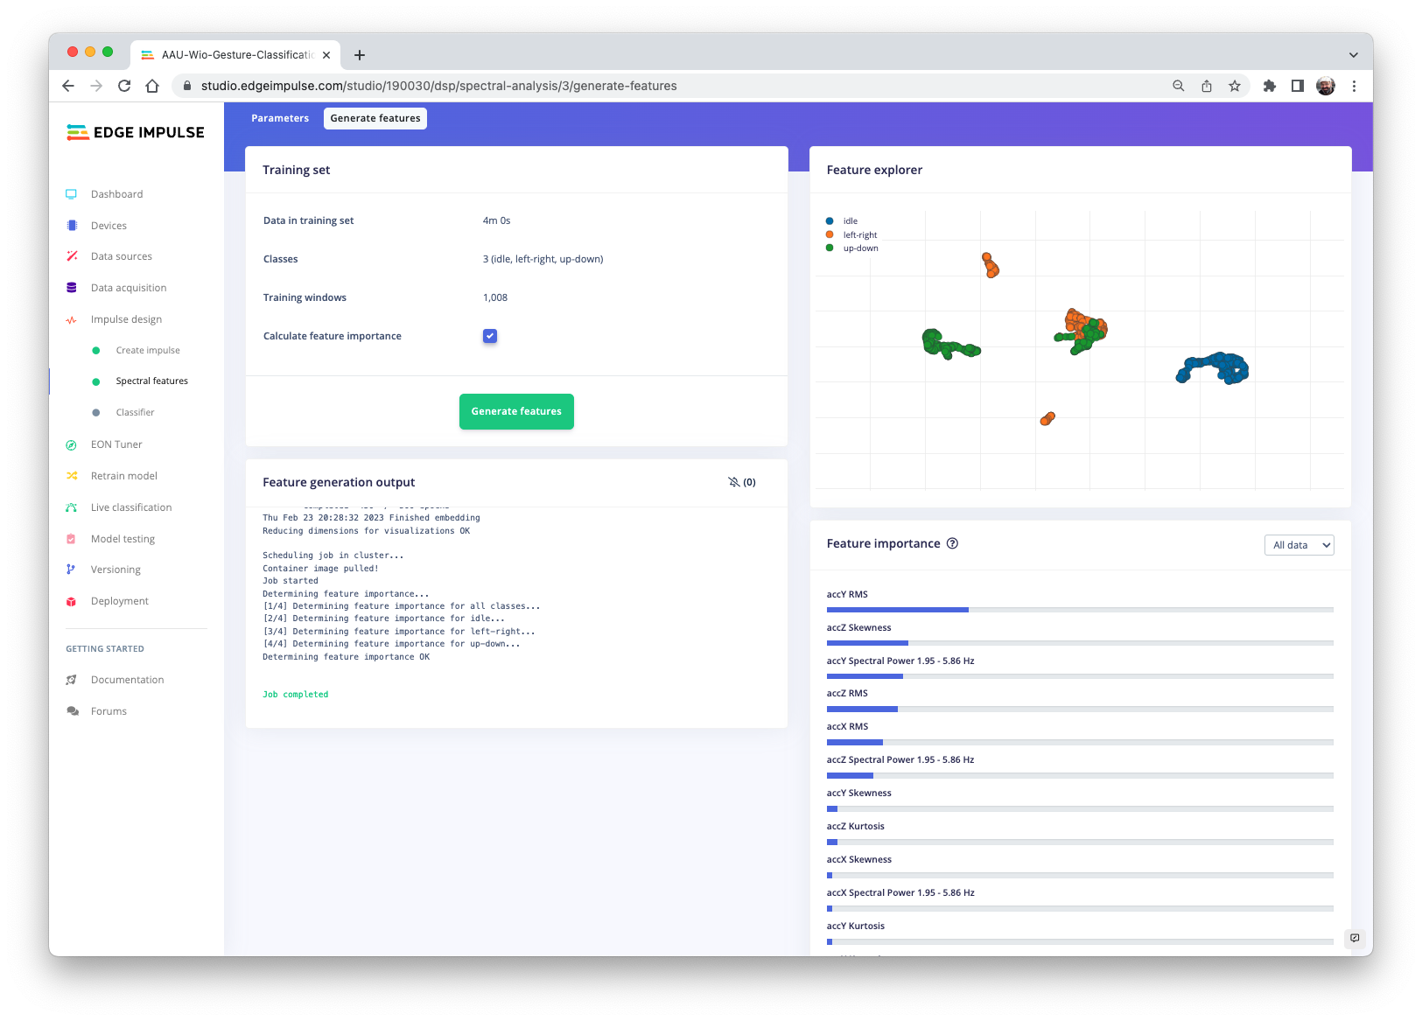

Slide 23
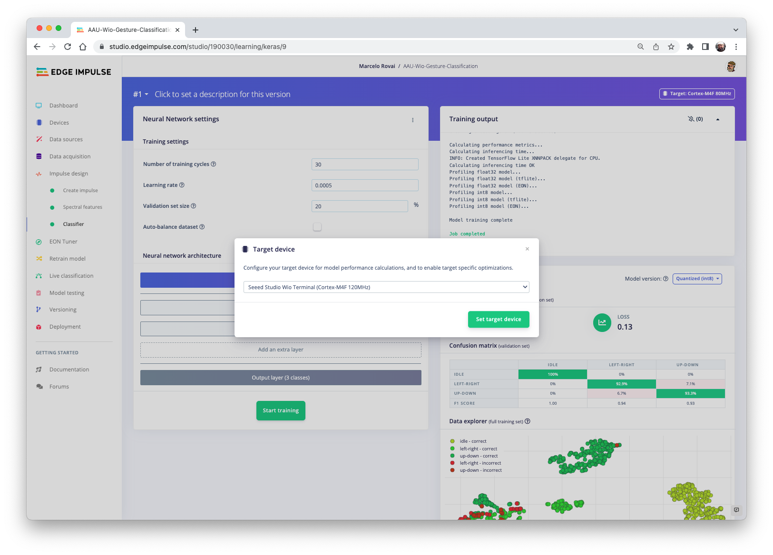

Slide 24
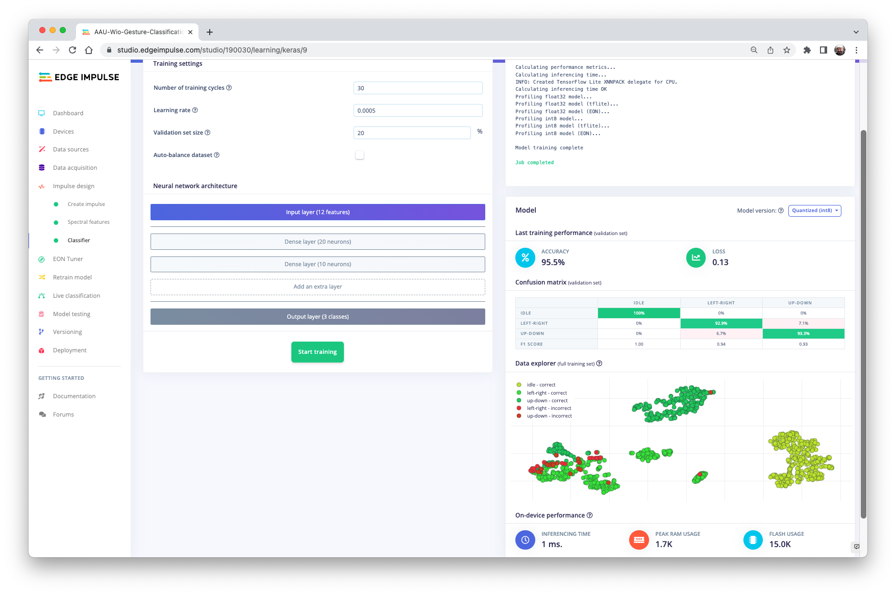

Slide 25
Pre-Processing Data
Design a Model
Train a Model

Slide 26
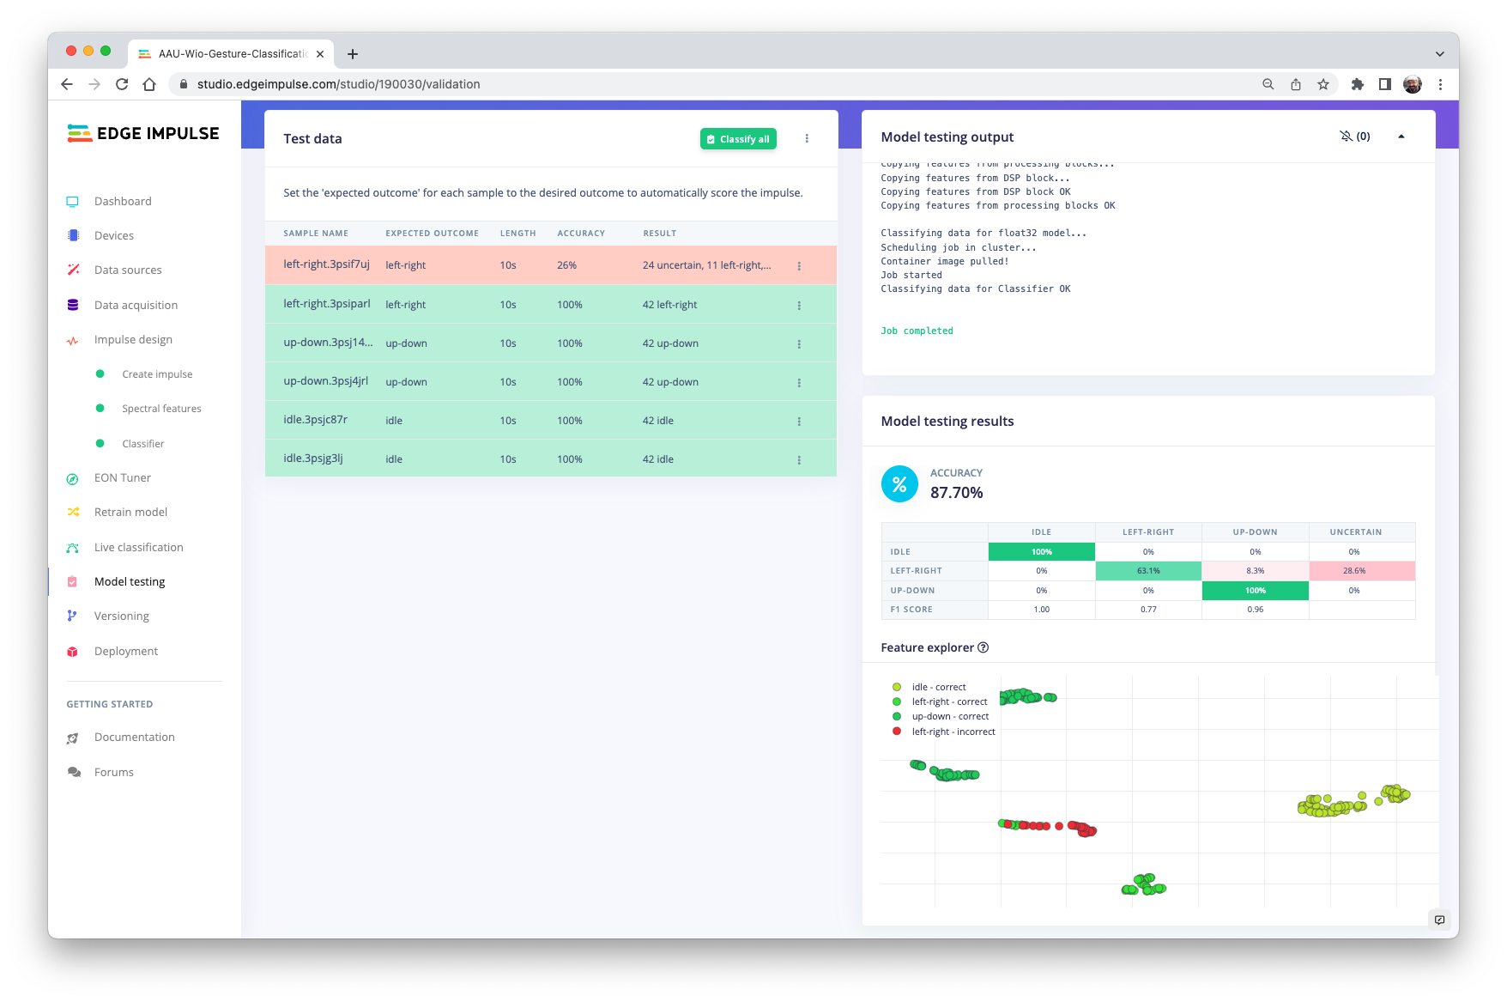
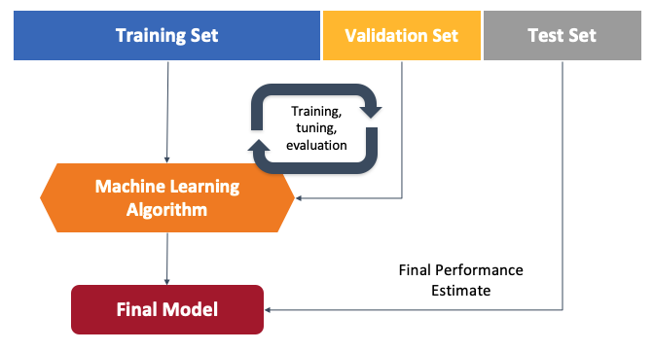

Slide 27
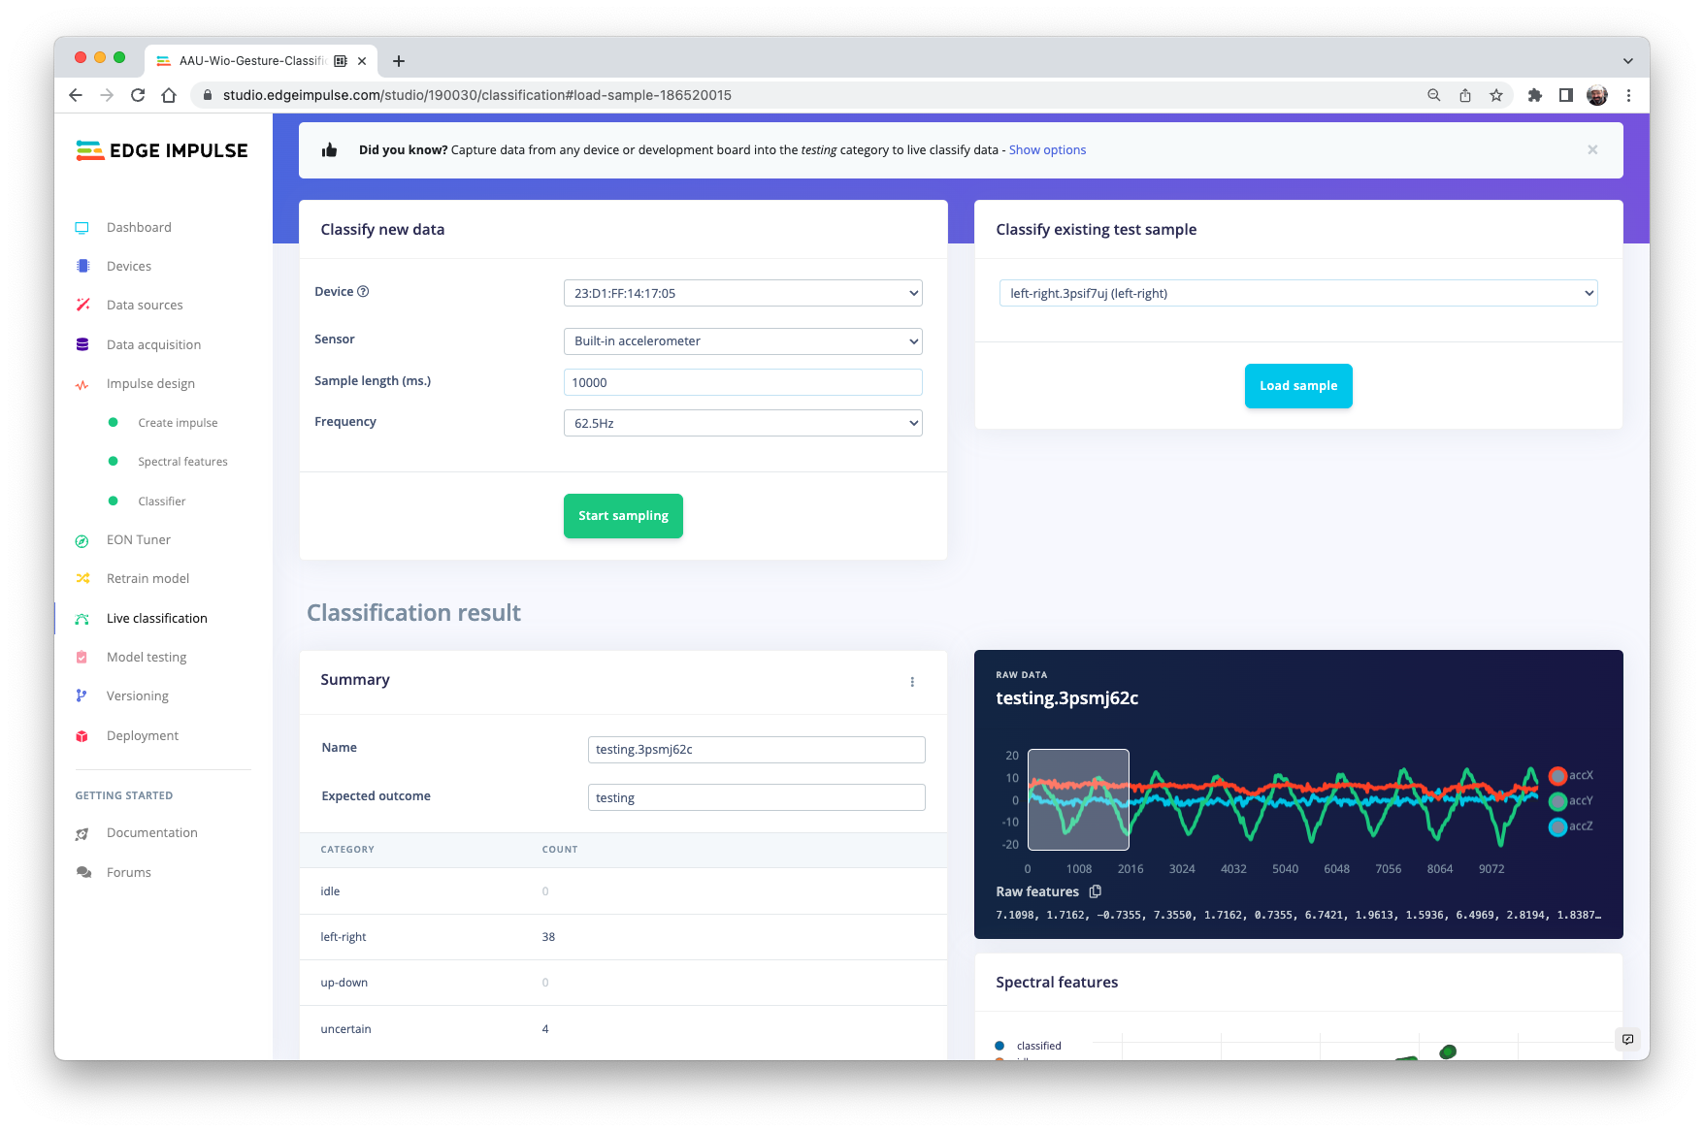

Slide 28
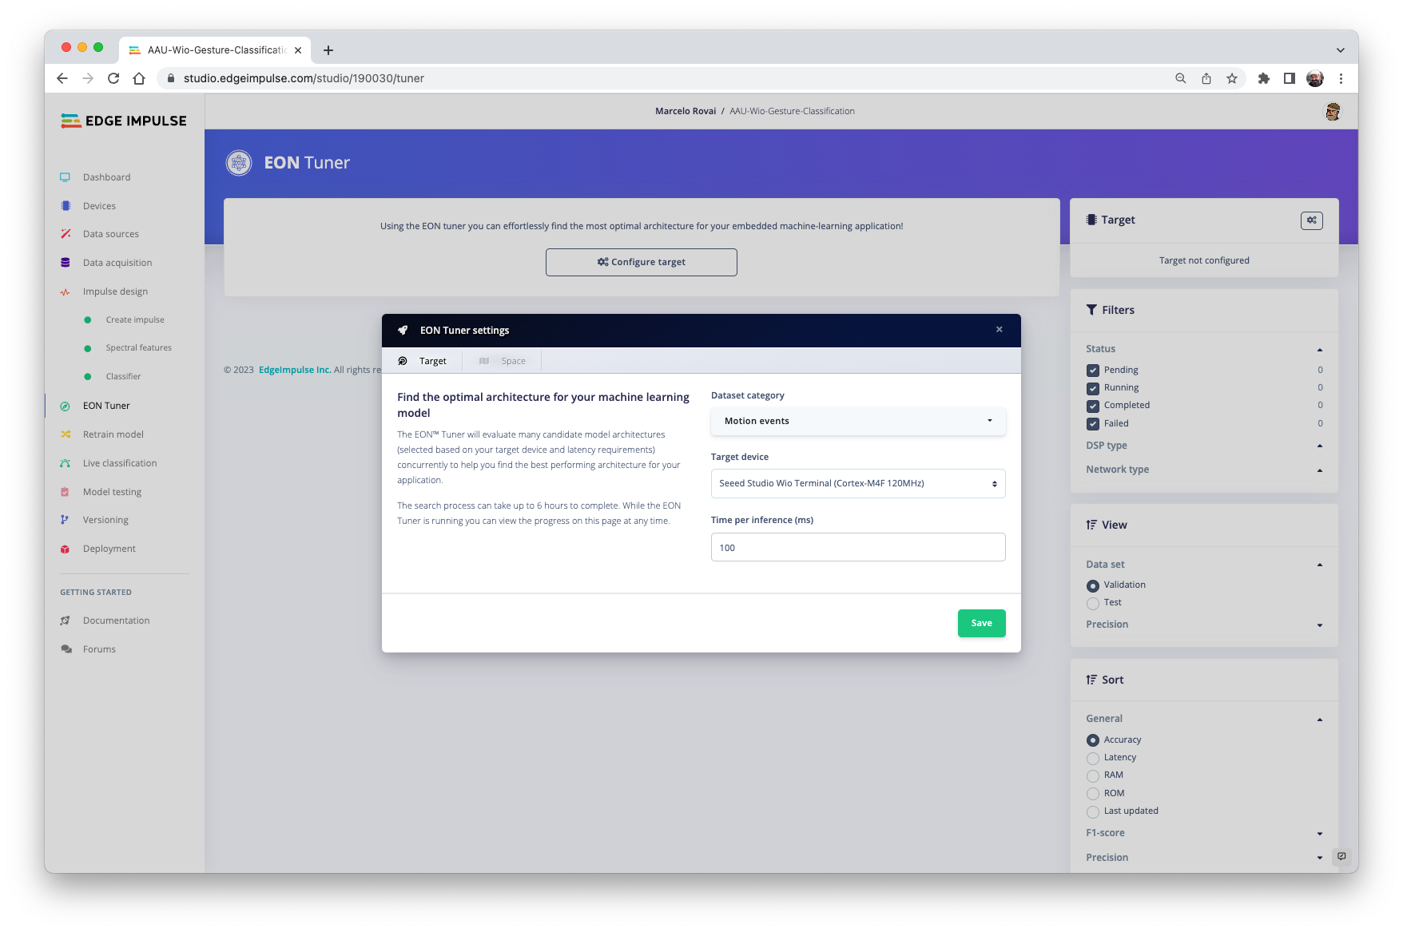

Slide 29
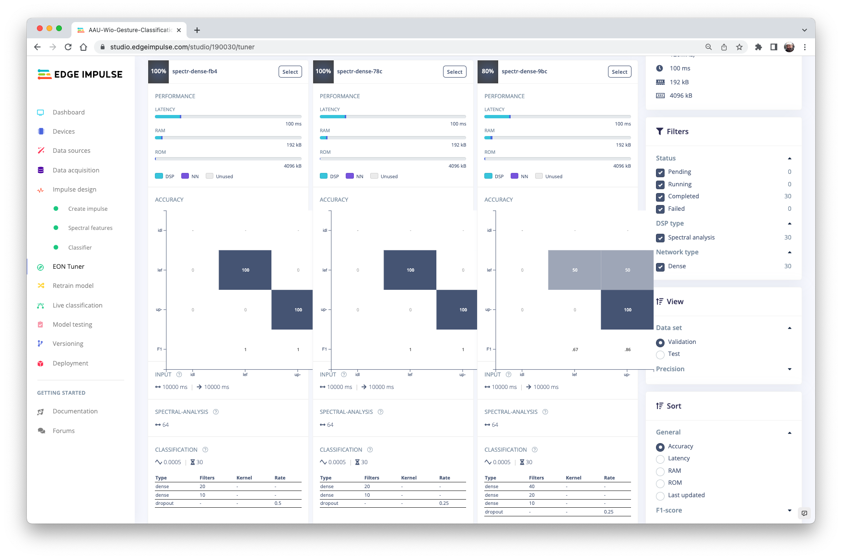

Slide 30
Pre-Processing Data
Design a Model
Train a Model

Slide 31
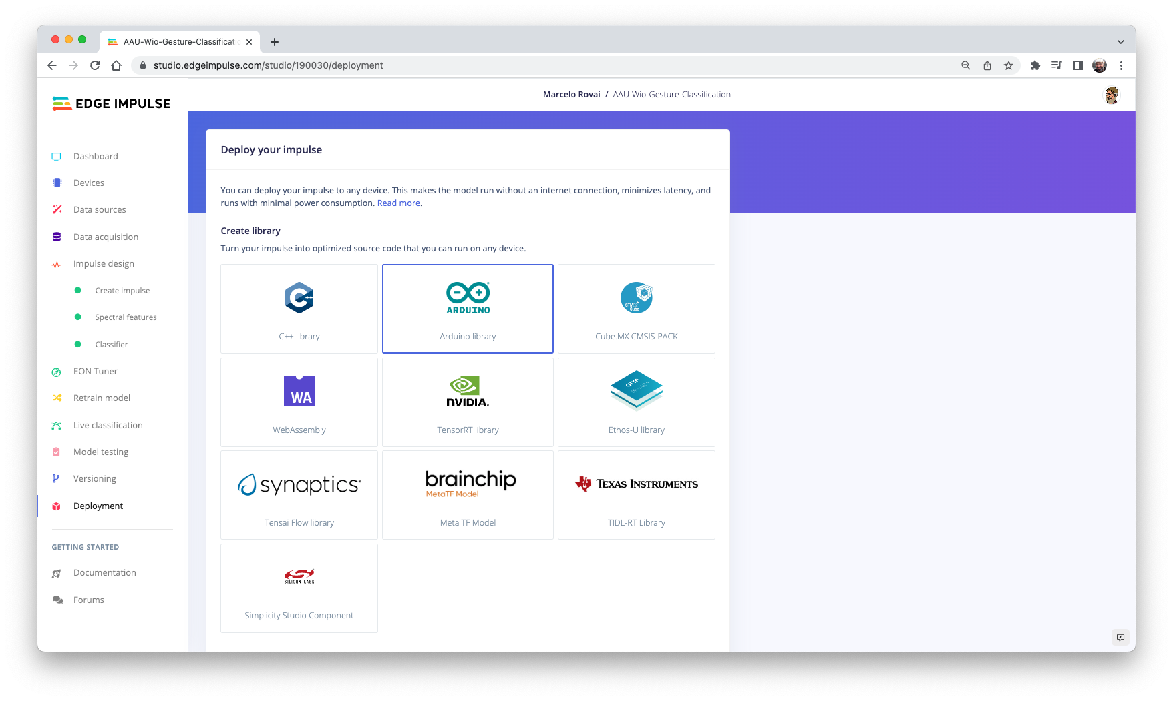

Slide 32
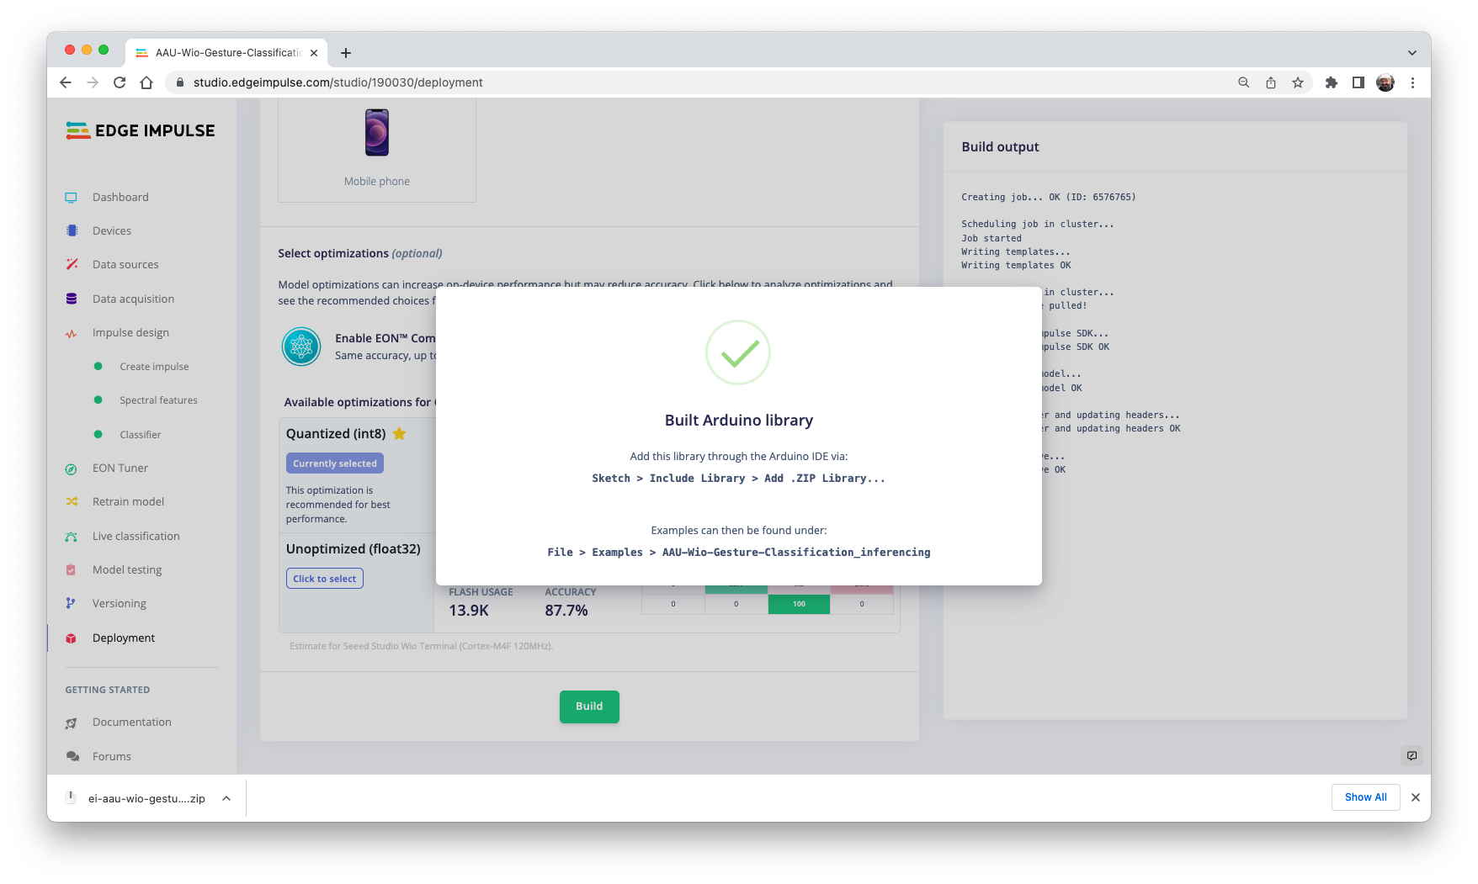

Slide 33
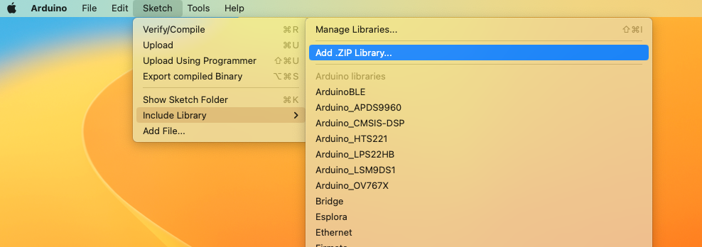
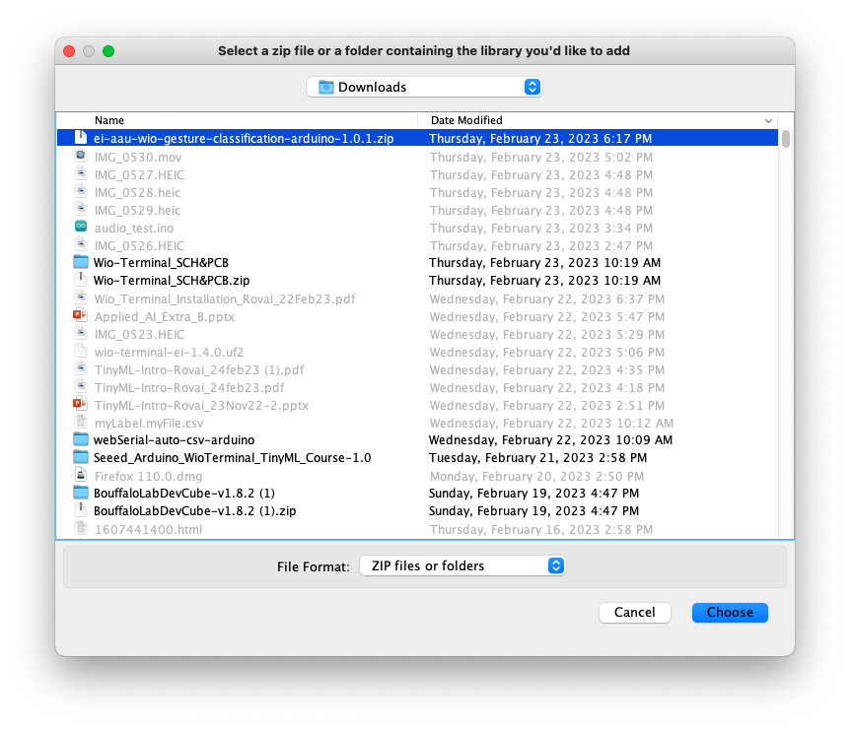
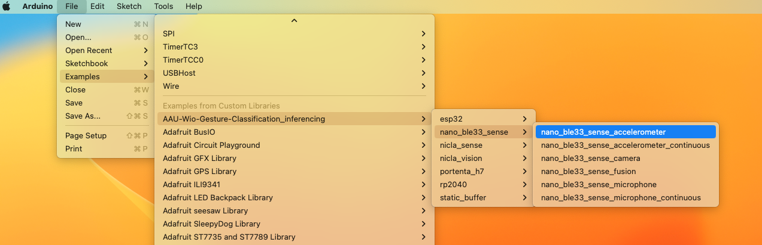

Slide 34
Model Inference

Slide 35
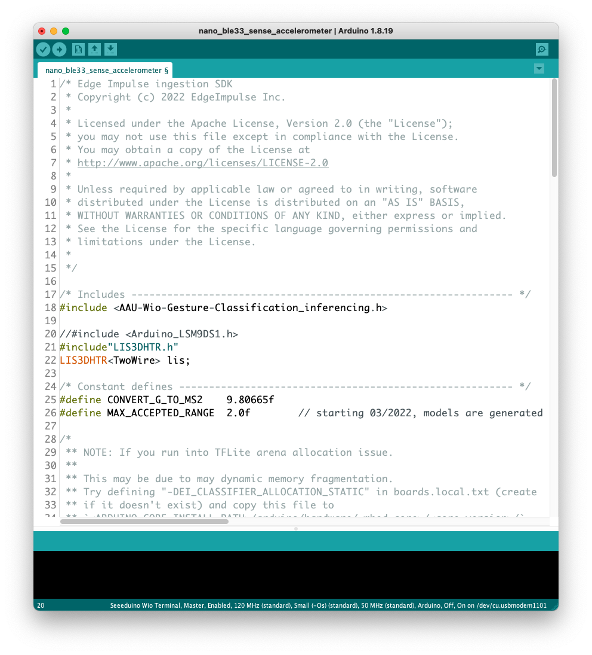
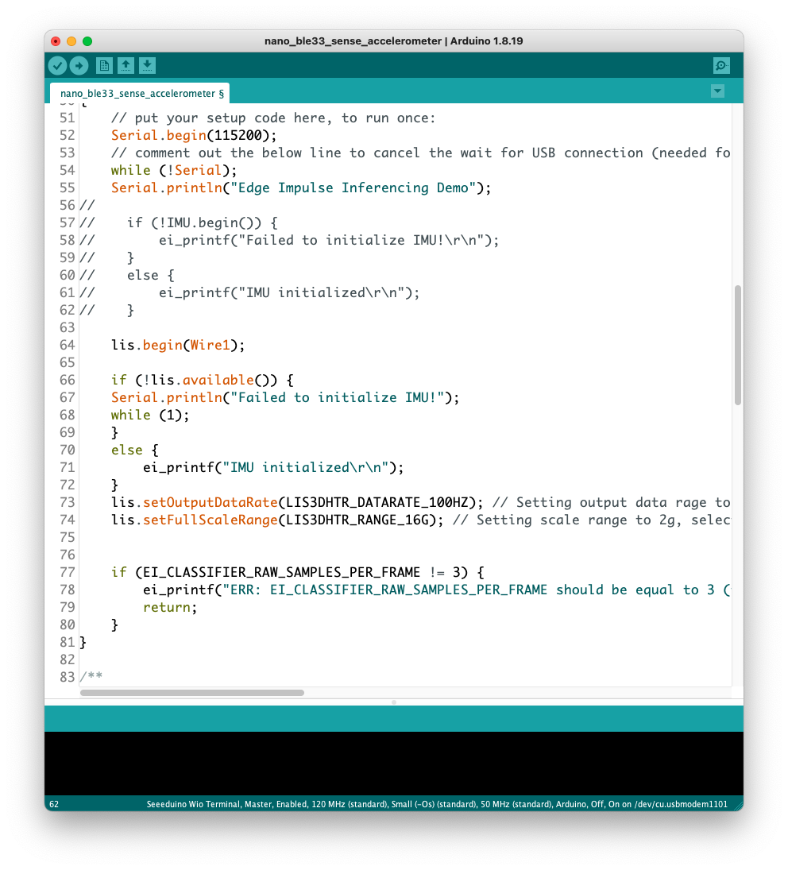
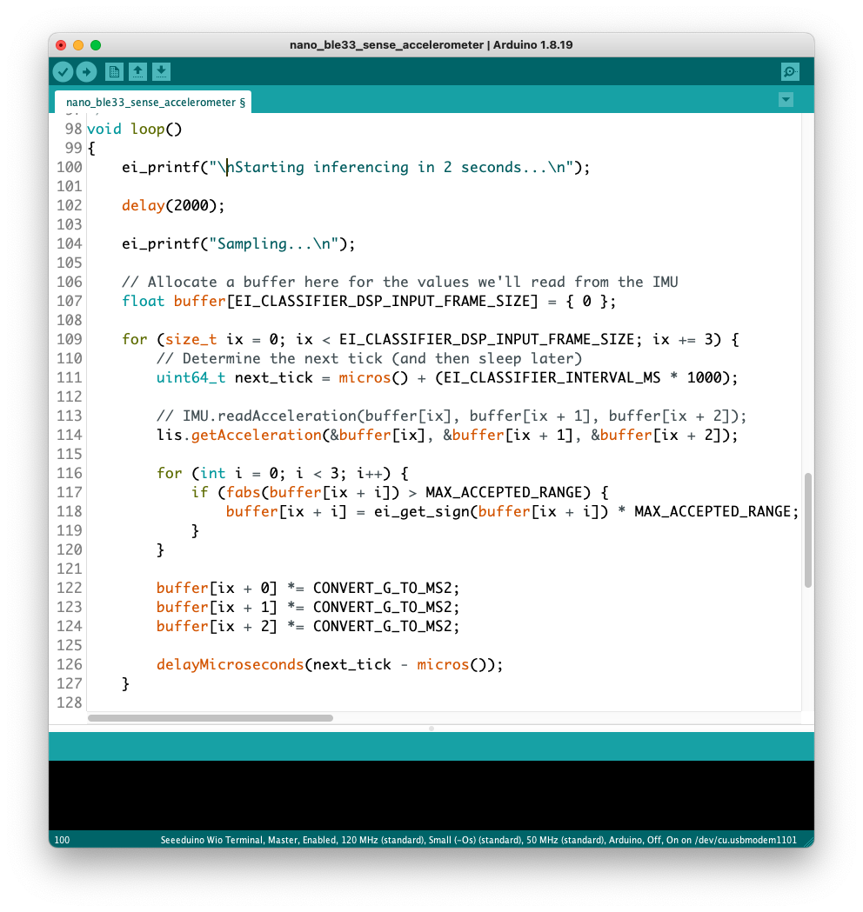
Changing the Arduino code to adapt the Wio Accelerometer

Slide 36
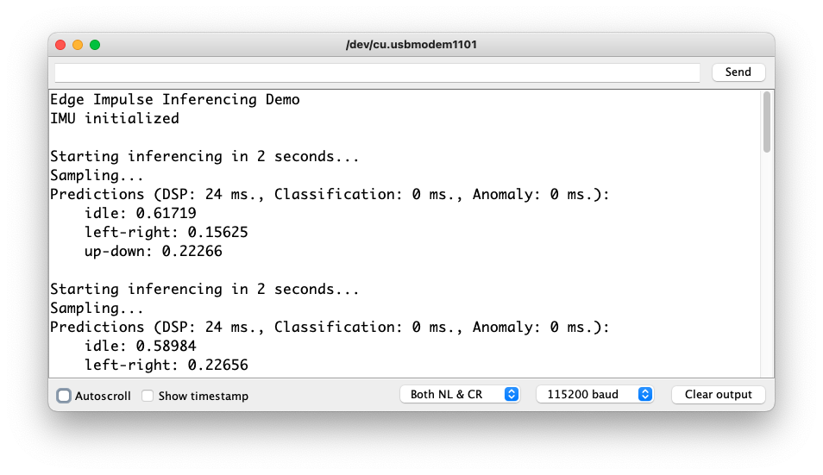
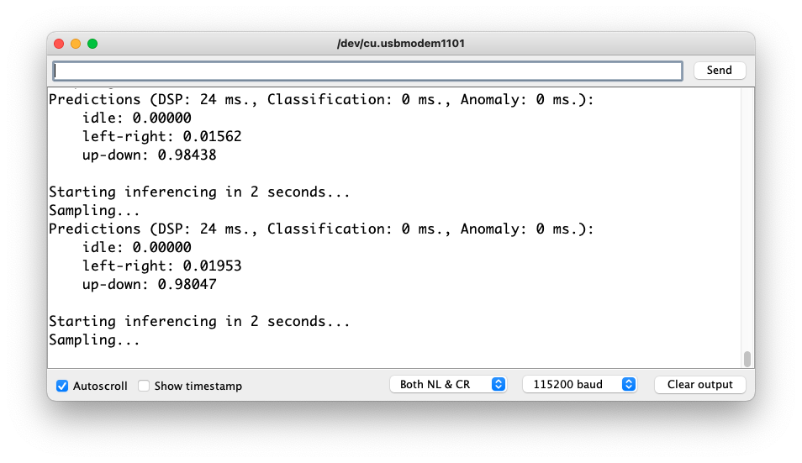
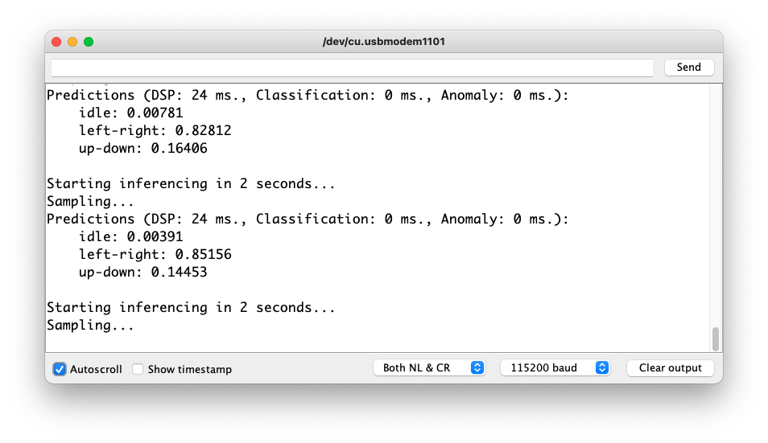
idle
up-down
left-right

Slide 37
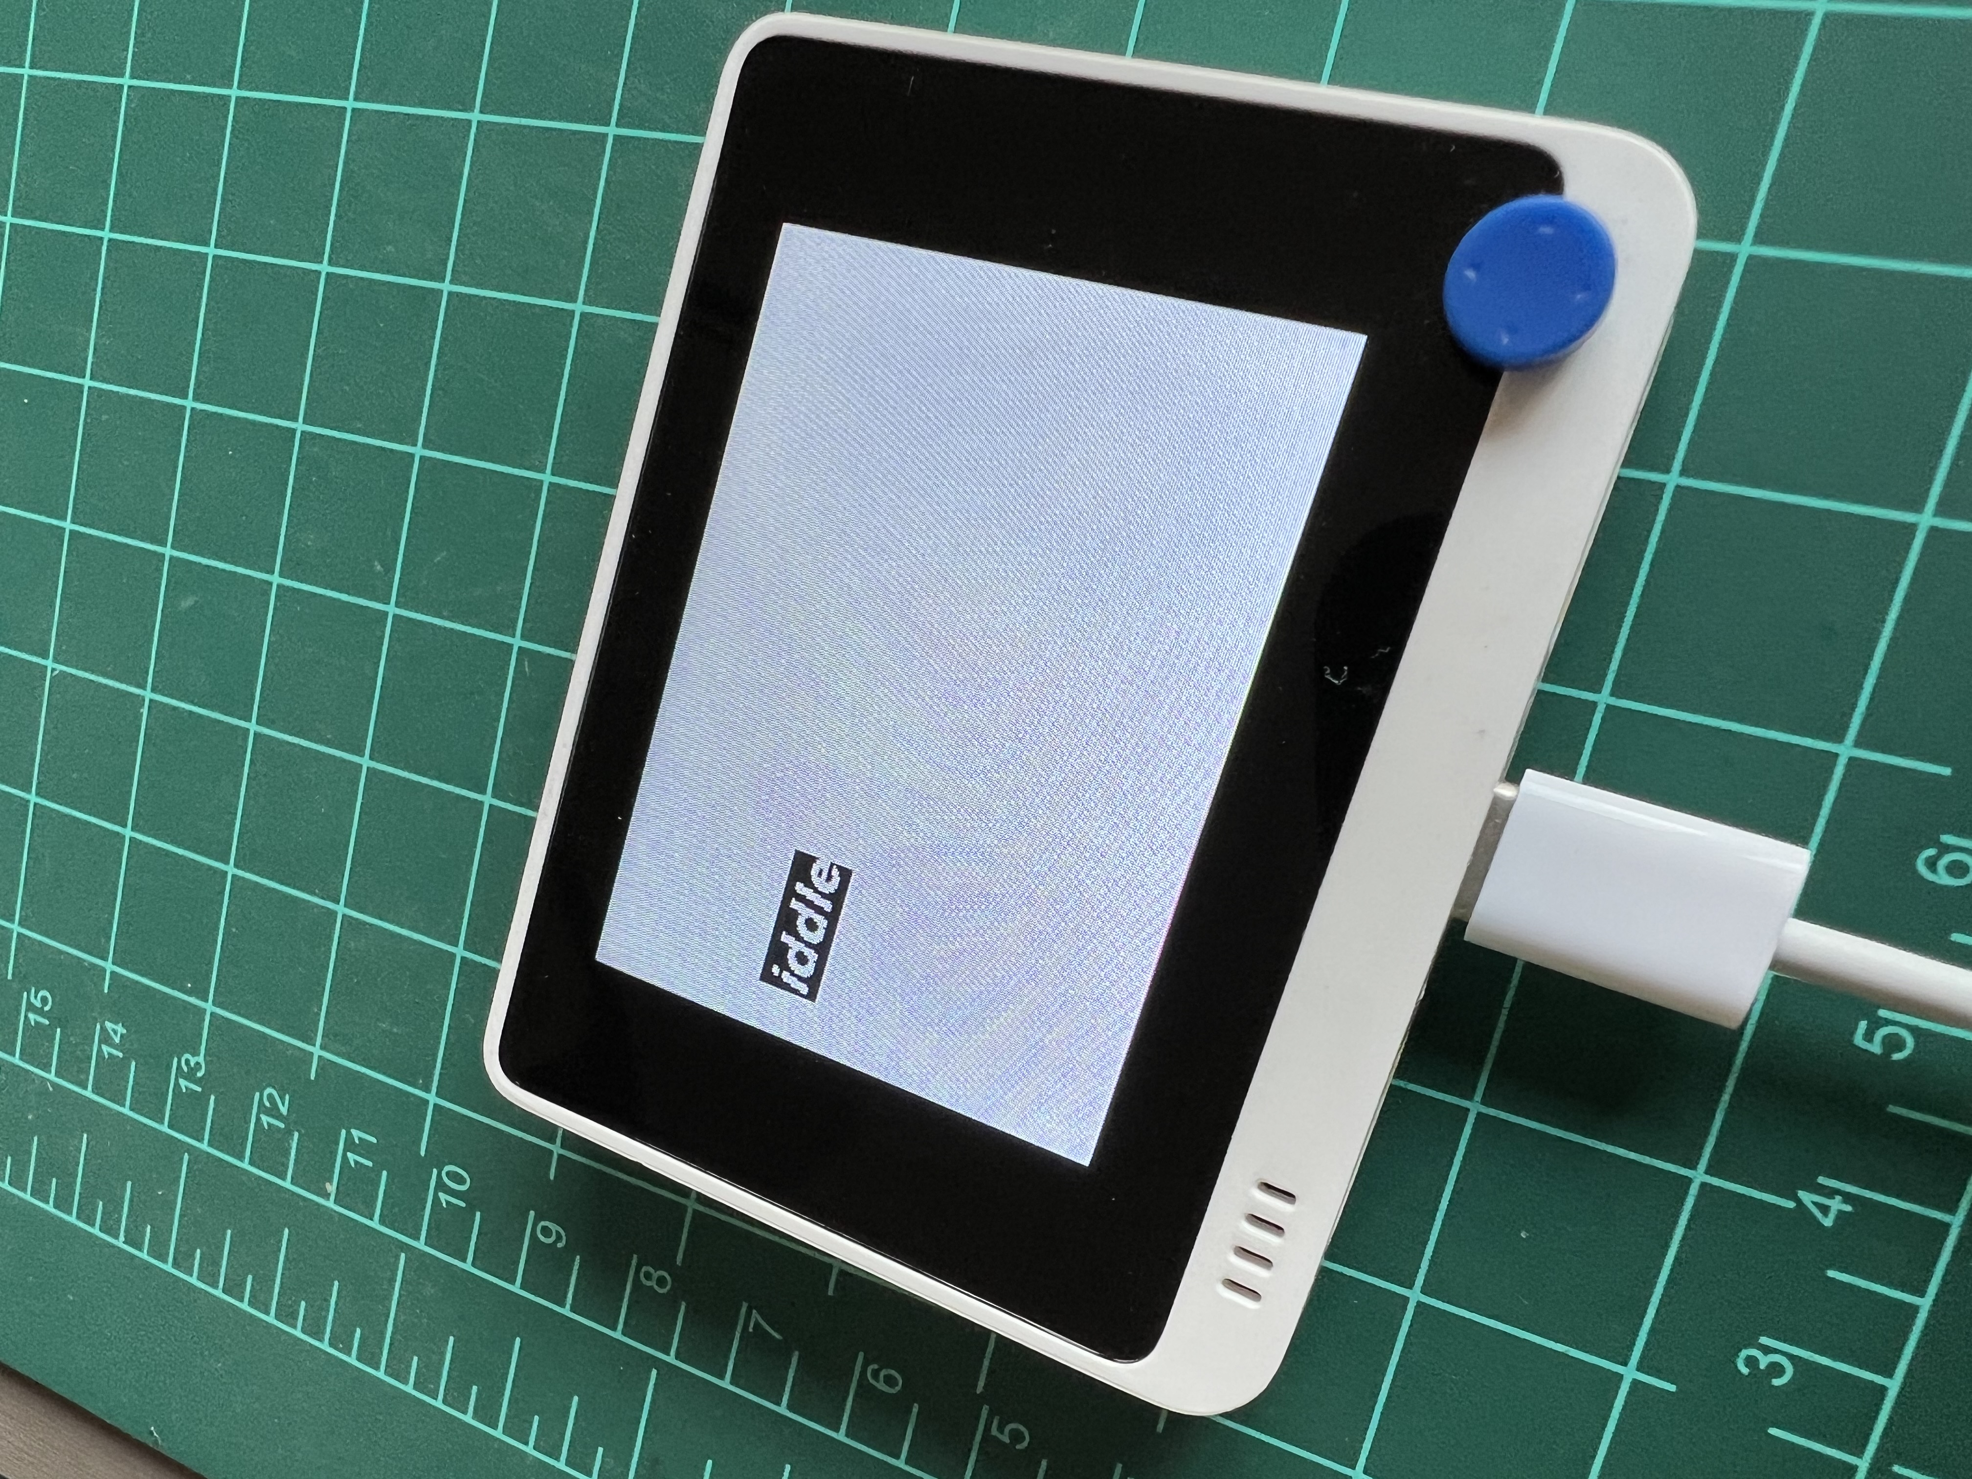
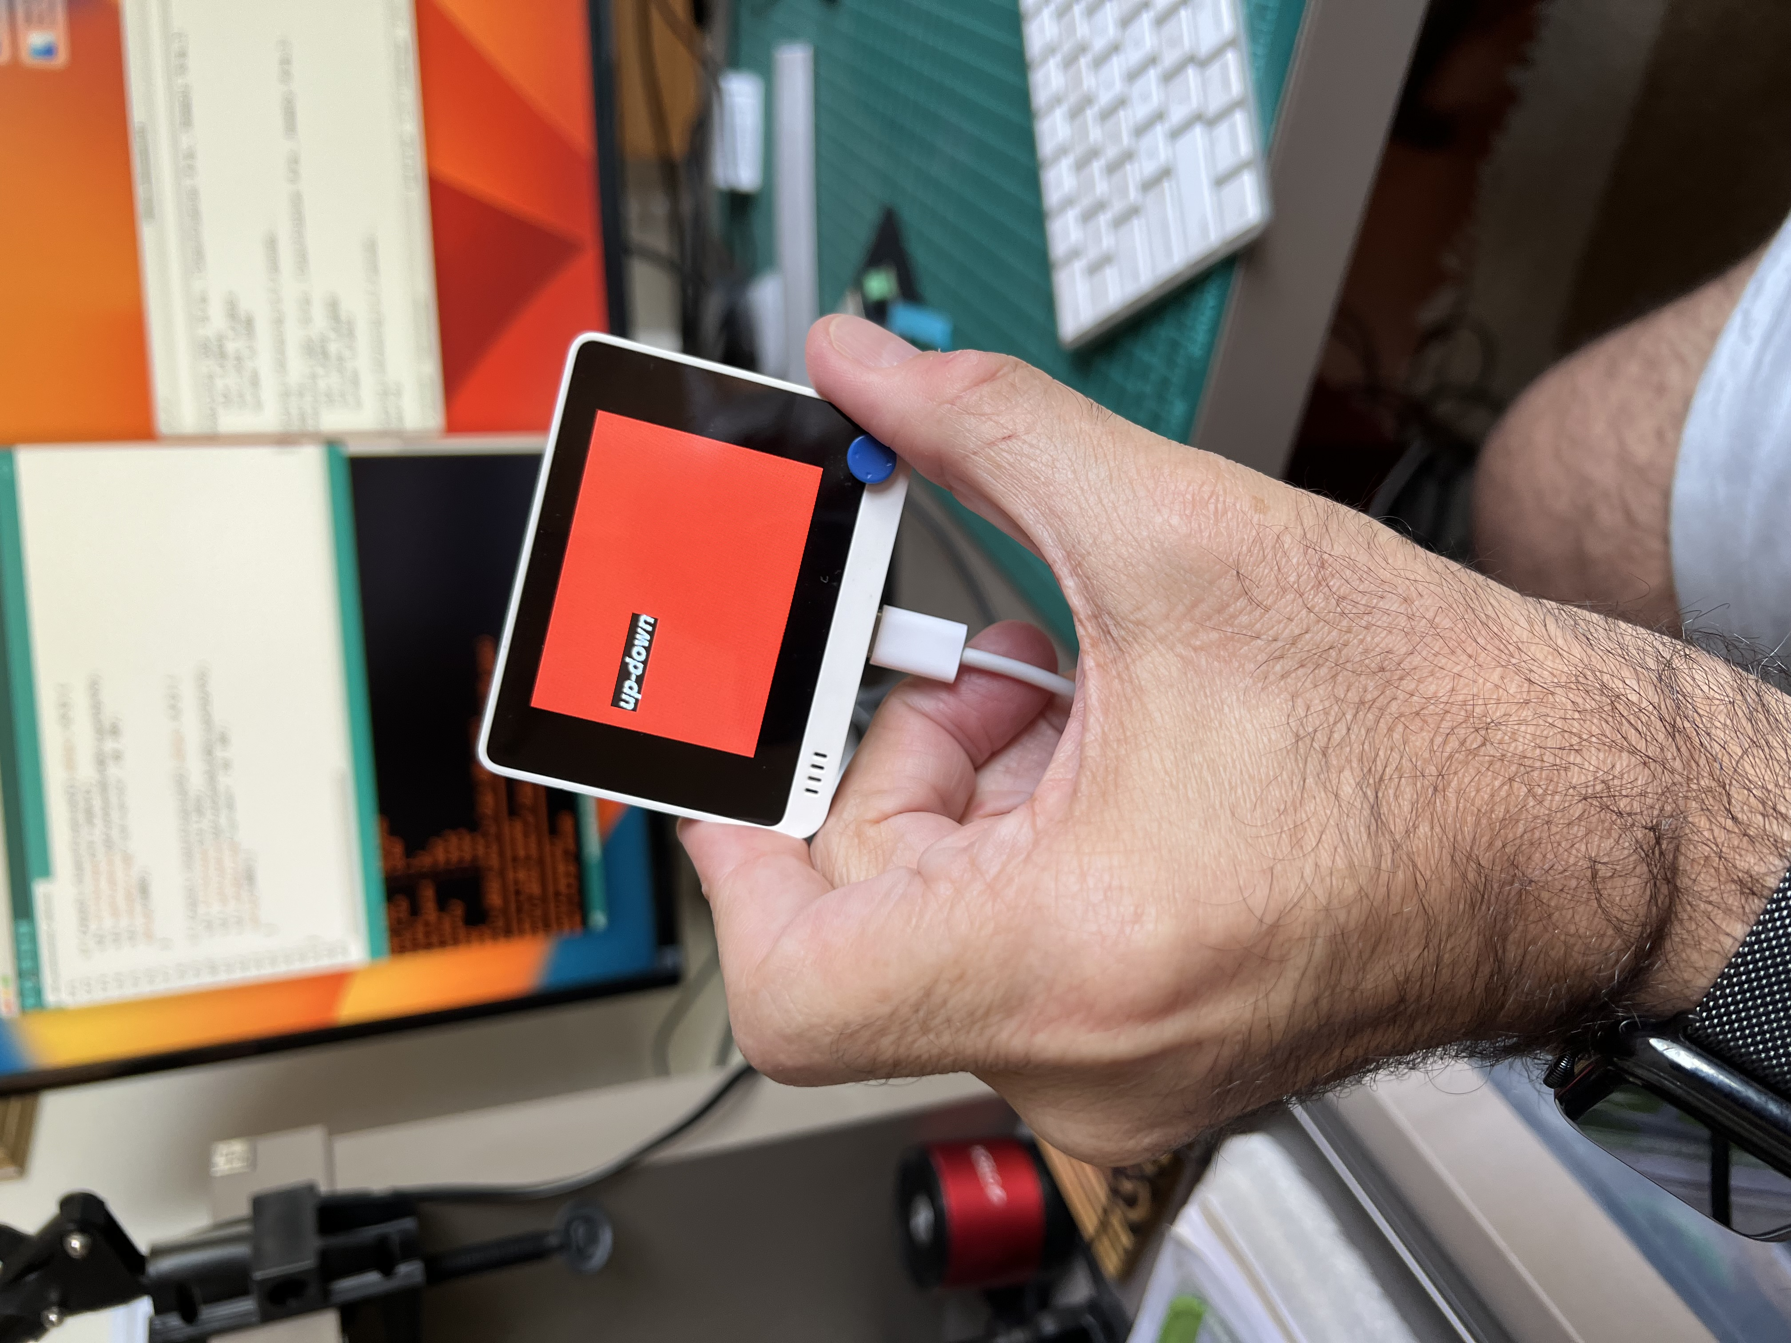
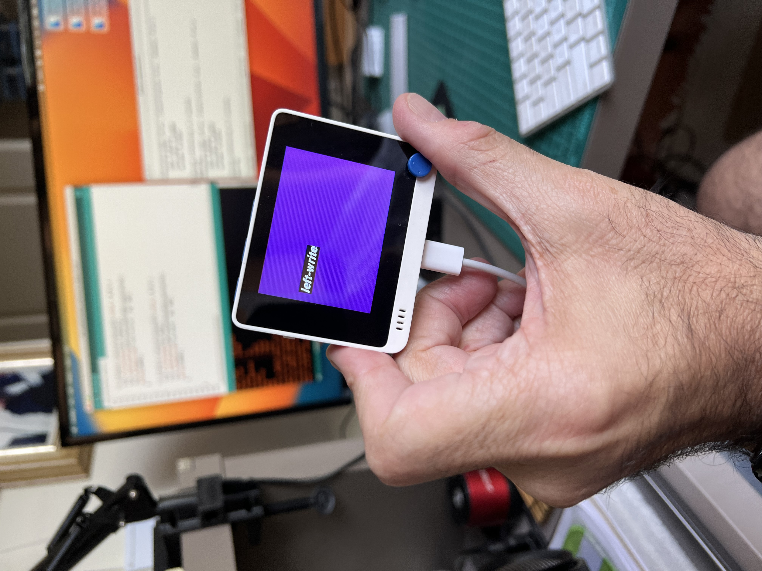
Including LCD for off-line Inference

Slide 38
Appendix Spectral Analysis

Slide 39
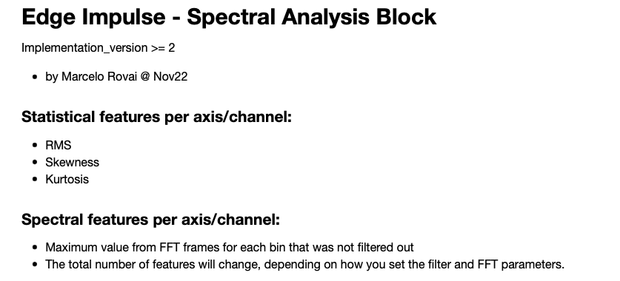
https://docs.edgeimpulse.com/docs/edge-impulse-studio/processing-blocks/spectral-features

Slide 40
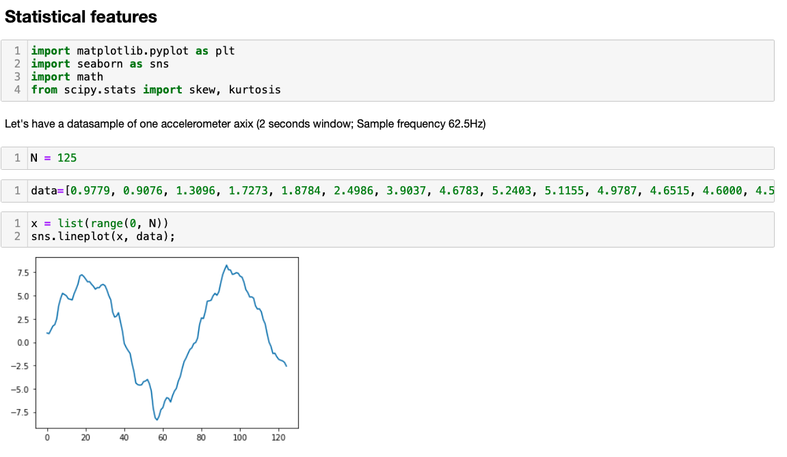

Slide 41
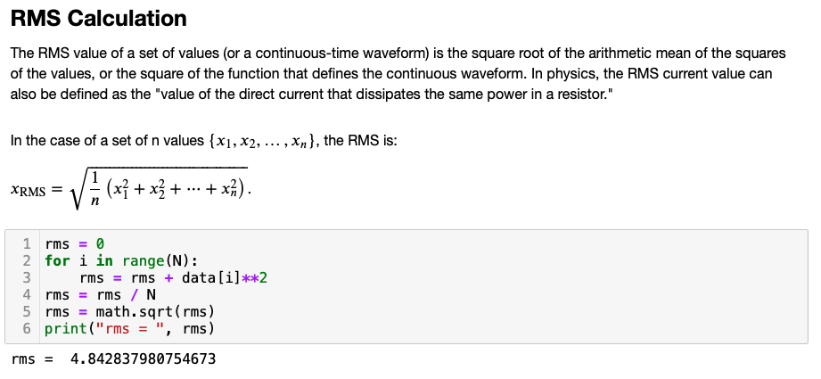

Slide 42
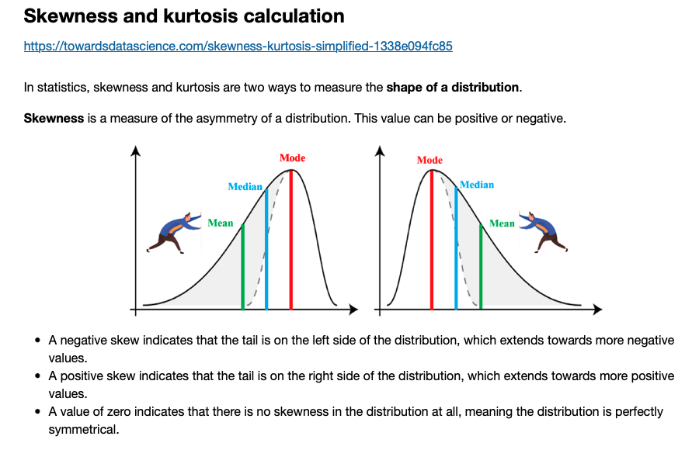
https://towardsdatascience.com/skewness-kurtosis-simplified-1338e094fc85

Slide 43
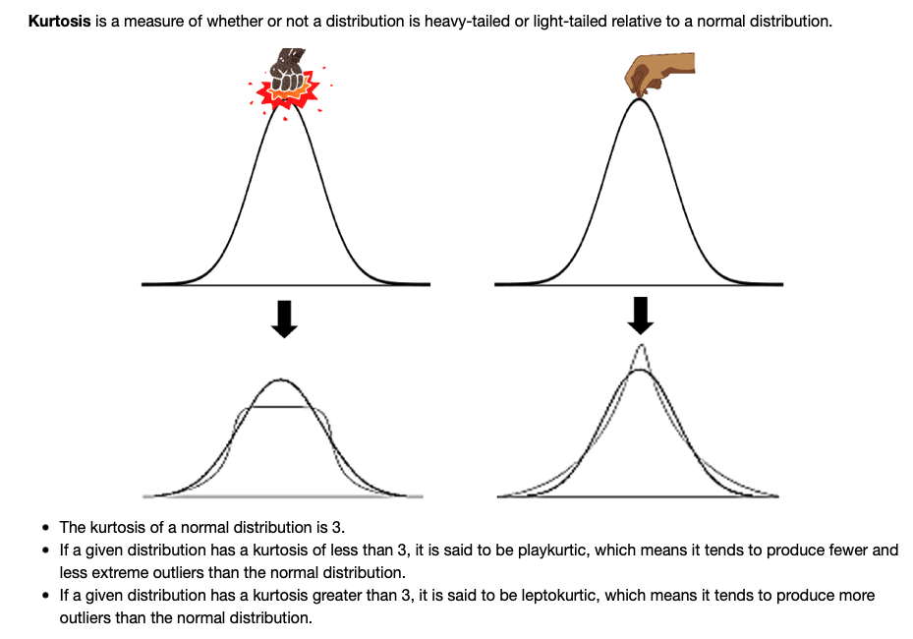

Slide 44
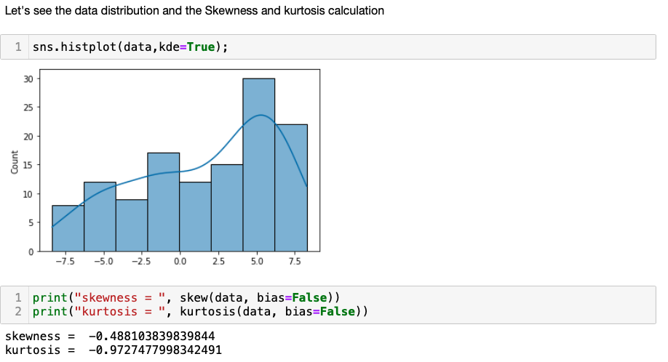

Slide 45
Thanks

